Slide 1
Husbands, love your wives,
even as Christ also loved the church,
and gave himself up for it.
- Ephesians 5:25 -

Slide 2
Biblical Truths about Marriage
God created marriage.
God has a purpose for a married man and woman.
Marriage is a symbol of Jesus’ love for the Church.

Slide 3
PUPPET SHOW: Joseph & Mary

Slide 4
MALE AND FEMALE, HE CREATED THEM
A husband and a wife, a husband and a wife,
Divinely joined together serving God throughout this life.
Male and female, He created them,
A bride and groom, to love and learn from Him.
It’s a picture, a loving mystery
Of Jesus as the Bridegroom, the Church, His bride.
He loved us, before the dawn of history.
He laid down His life, for our sins He died.

Slide 6
TRAIN UP A CHILD
Train up a child. Train up a child.
On their own, they’re loud and messy And a teeny bit wild.
This world is all a jumble; they don’t know what to do.
So, God gave them parents to lead them wisely through.

Slide 7
God has a special job for every mom and dad to do—
Teach your child to follow after Christ and cling to what is true.
Plant treasures from God’s word down deep in their hearts.
The nurture of the Lord—That’s where wisdom truly starts.

Slide 8
Train up a child. Train up a child.
On our own, we’re loud and messy And a teeny bit wild.
This world is all a jumble; we don’t know what to do.
So, God gave us parents to lead us wisely through.

Slide 9
ADOPTION, GOD’S OPTION OF LOVE
Adoption, God’s option of love,
Adoption, God’s option of love,
Chosen heirs of our parents,
We’ll share our God blessed home.
Adoption, God’s option of love.

Slide 10
Welcomed by hearts of love
To a family who has prayed
For this child to fill with joy
This treasured home God made.

Slide 11
Adoption, God’s option of love,
Adoption, God’s option of love,
Chosen heirs of our Father,
We’ll share His heav’nly home.
Adoption, God’s option of love.

Slide 12
Welcomed by God’s great love,
To His family from above;
Jesus paid the price for all
Who trust Him and believe.

Slide 13
Adoption, God’s option of love,
Adoption, God’s option of love,
Chosen heirs of our Father,
We’ll share His heav’nly home.
Adoption, God’s option of love.

Slide 14
Genesis 1:27
So God created man in his own image, in the image of God
created he him; male and
female created he them.”

Slide 15
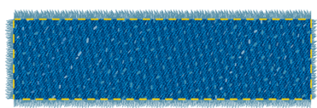
Genesis 1:27
So God created man in his own image, in the image
of God created he him; male and female created
he them.”

Slide 16
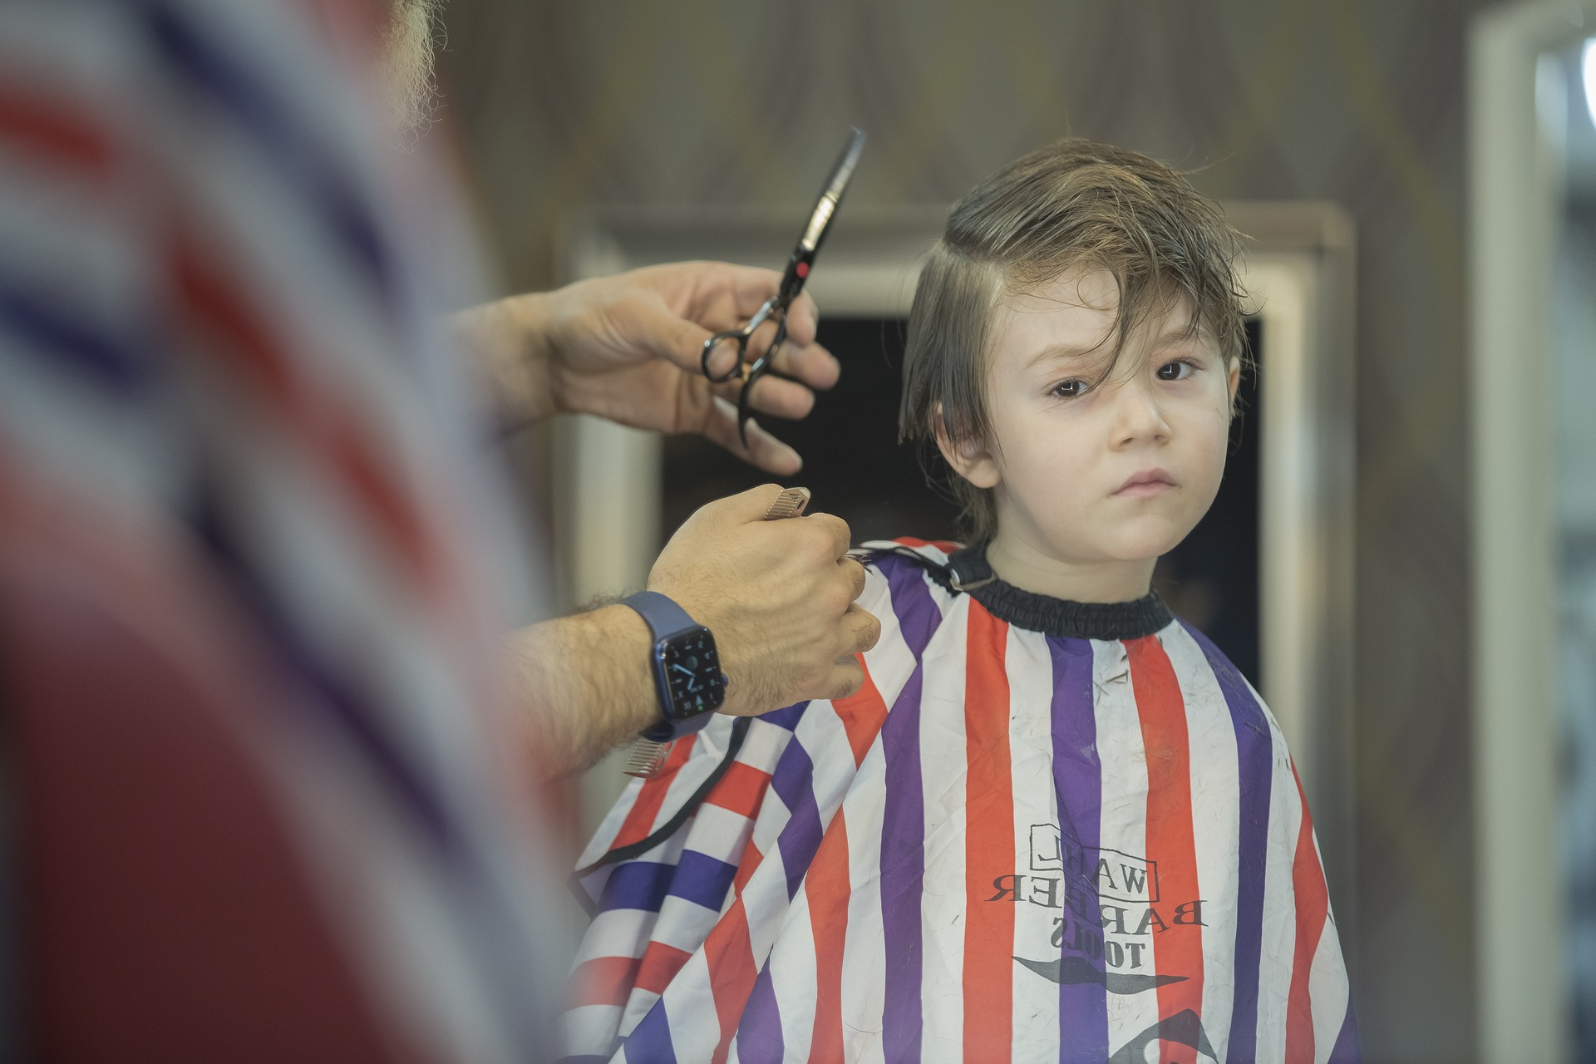
Things We Alter

Slide 17
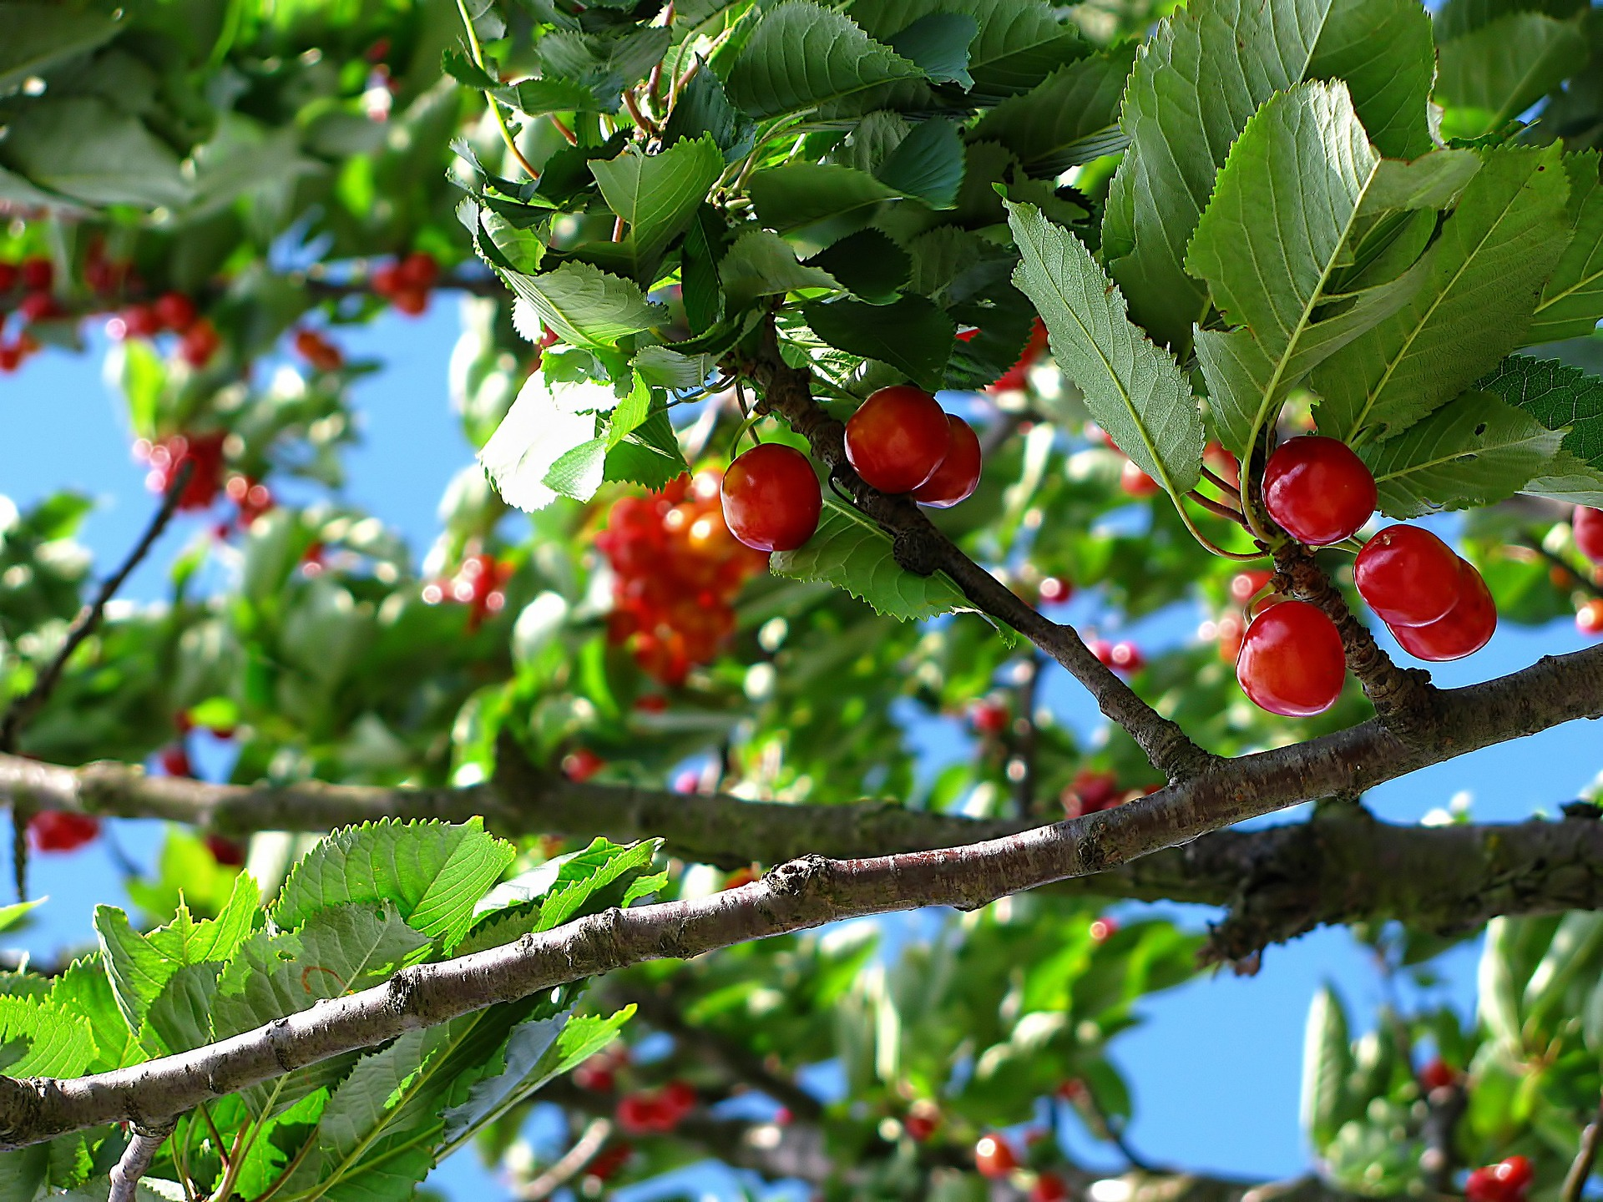
Alterations in God’s Creation

Slide 18
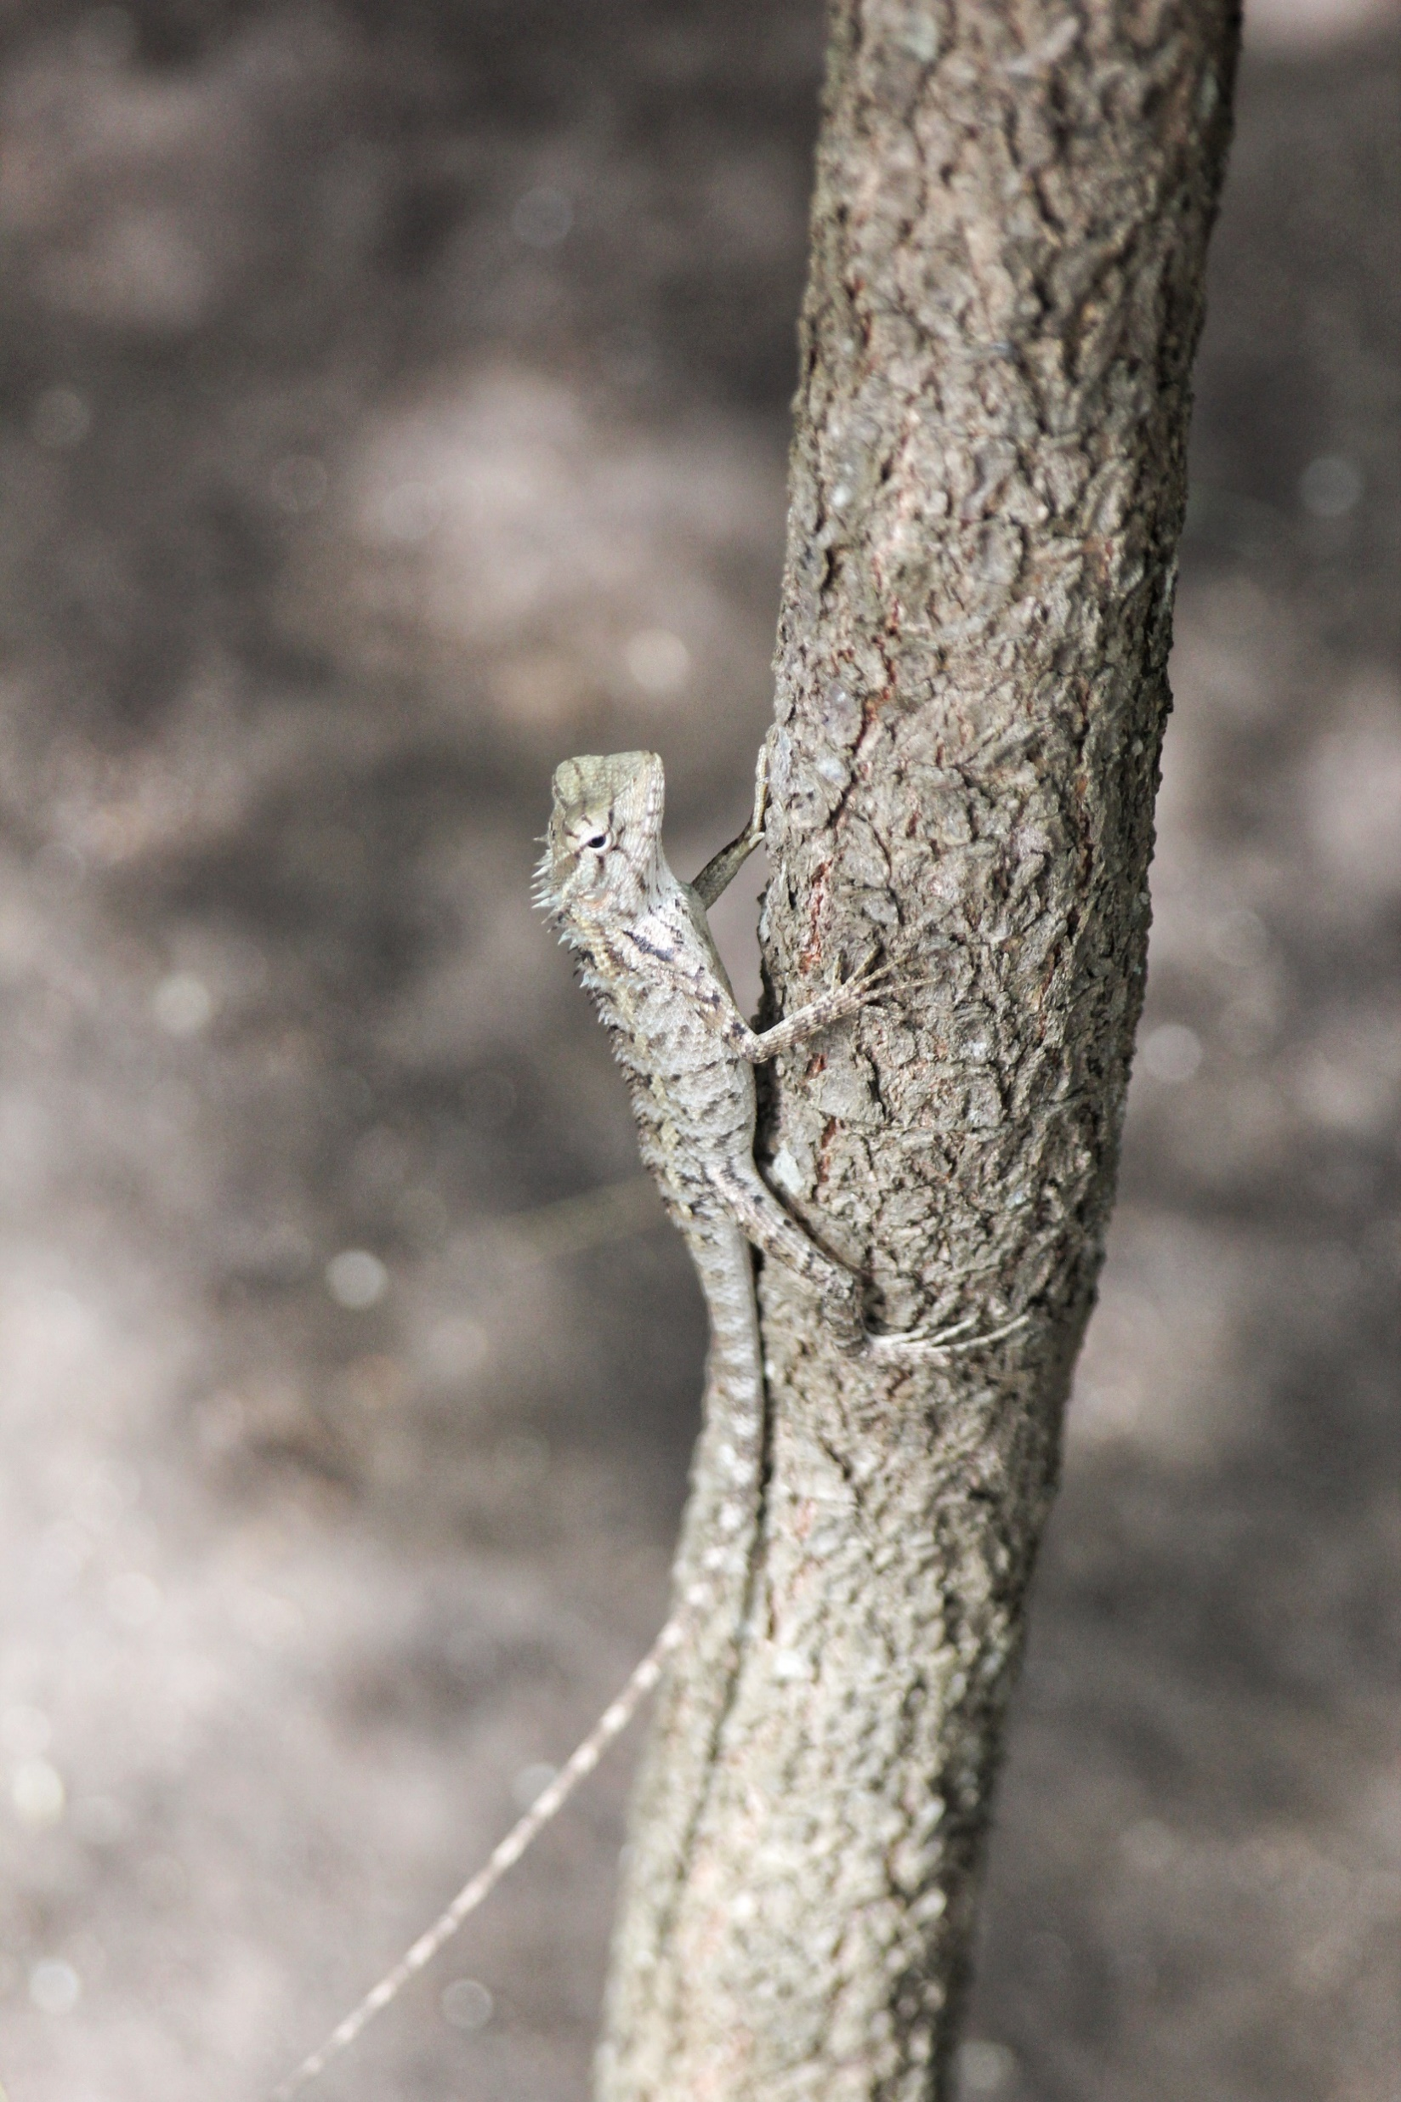
Alterations in God’s Creation

Slide 19
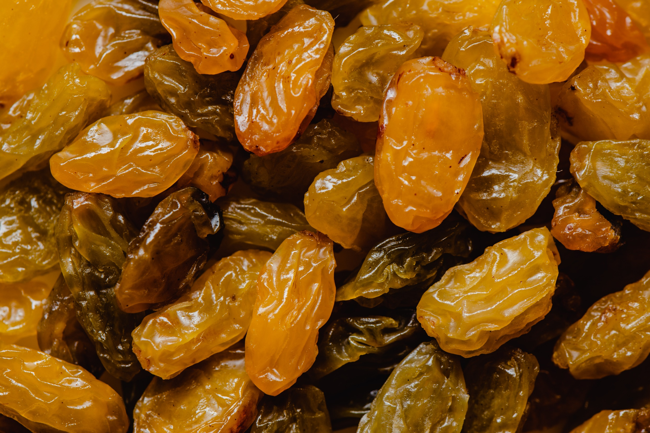
Alterations in God’s Creation

Slide 20
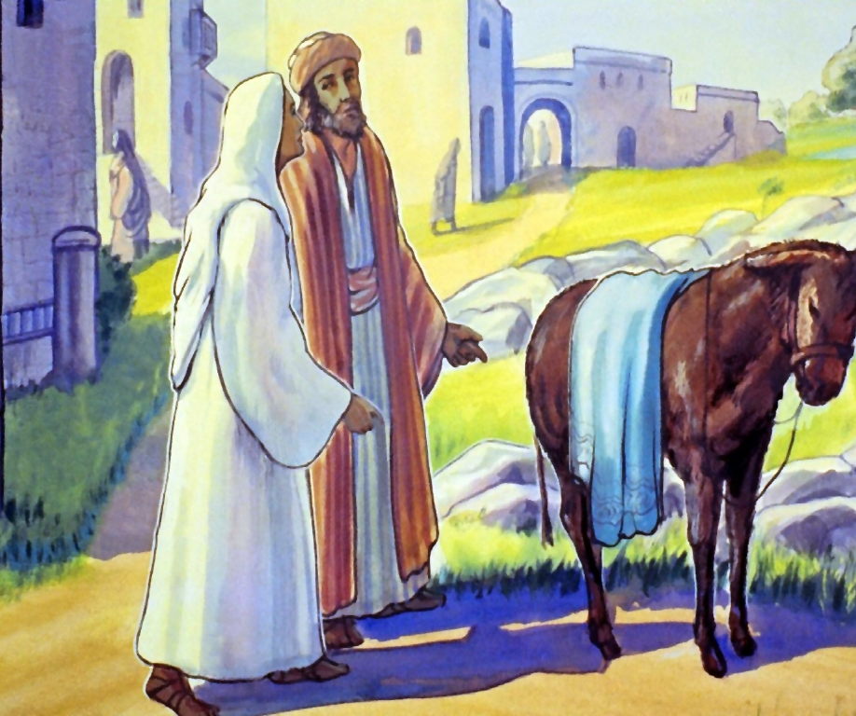
THE ALTERATIONS:
The Story of
Joseph & Mary

Slide 22
^{Jeremiah 23:5}
“Behold the days come, saith the LORD, that I will raise unto David a righteous Branch, and a King shall reign and prosper, and shall execute judgment and justice in the earth.”

Slide 23
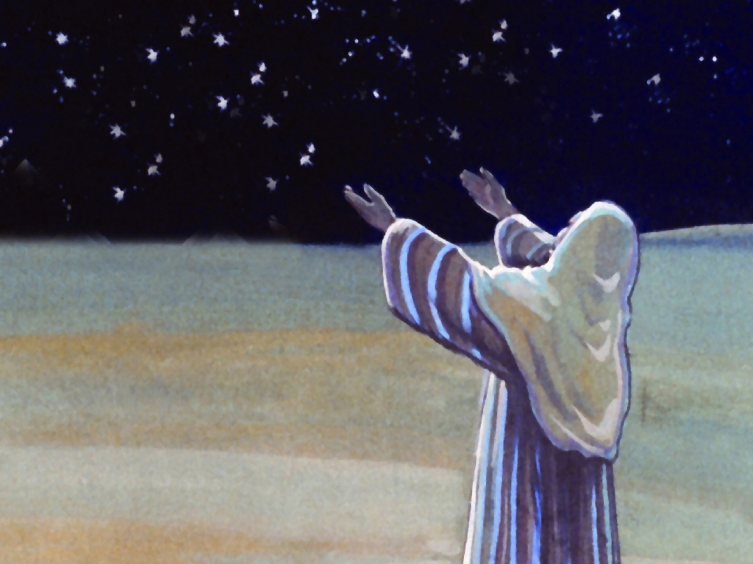
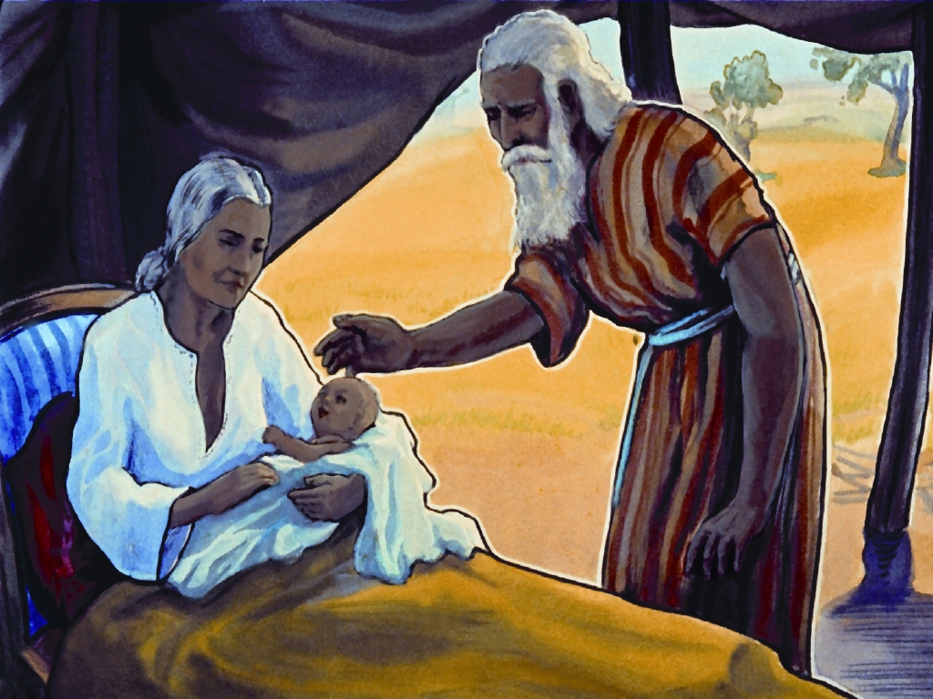

Slide 24
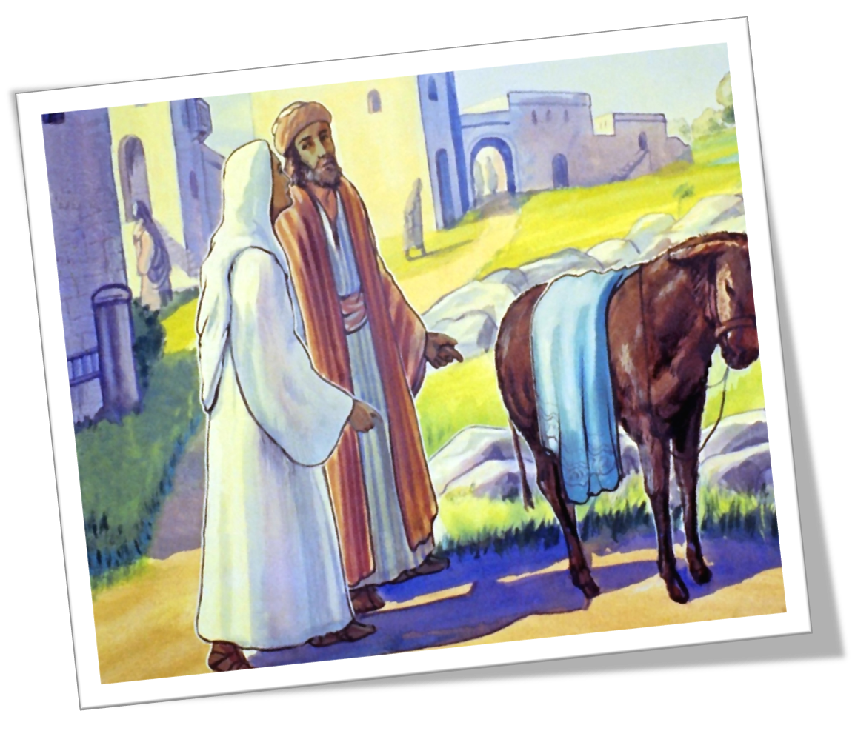
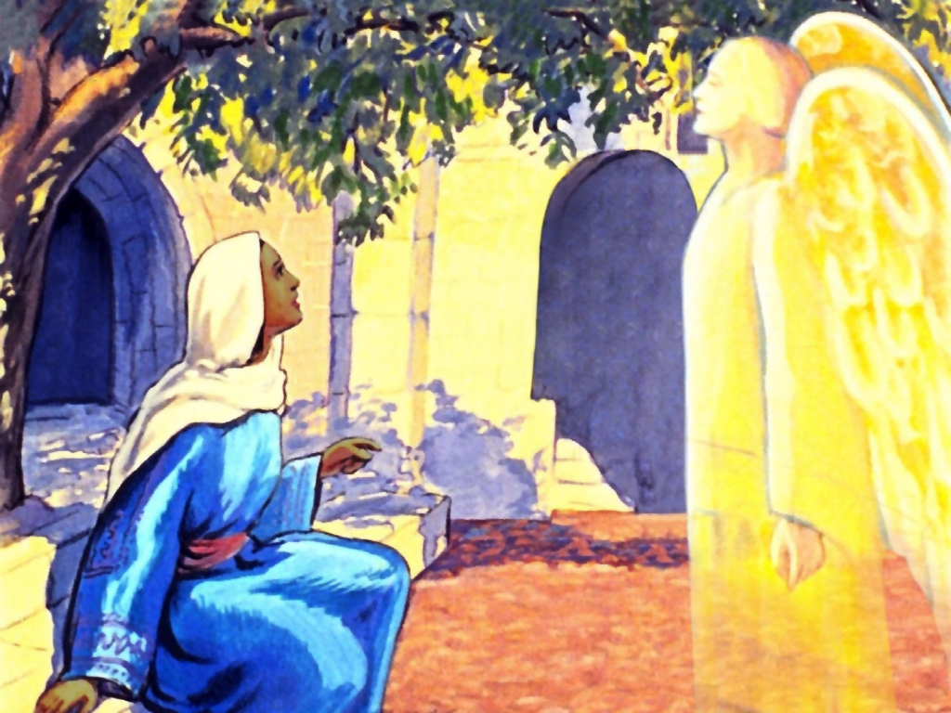

Slide 25
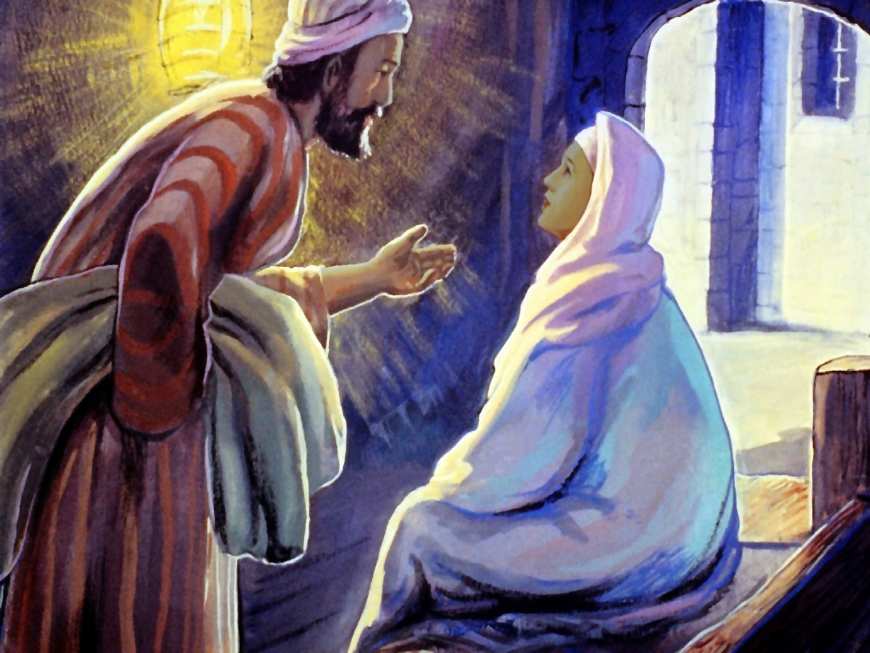
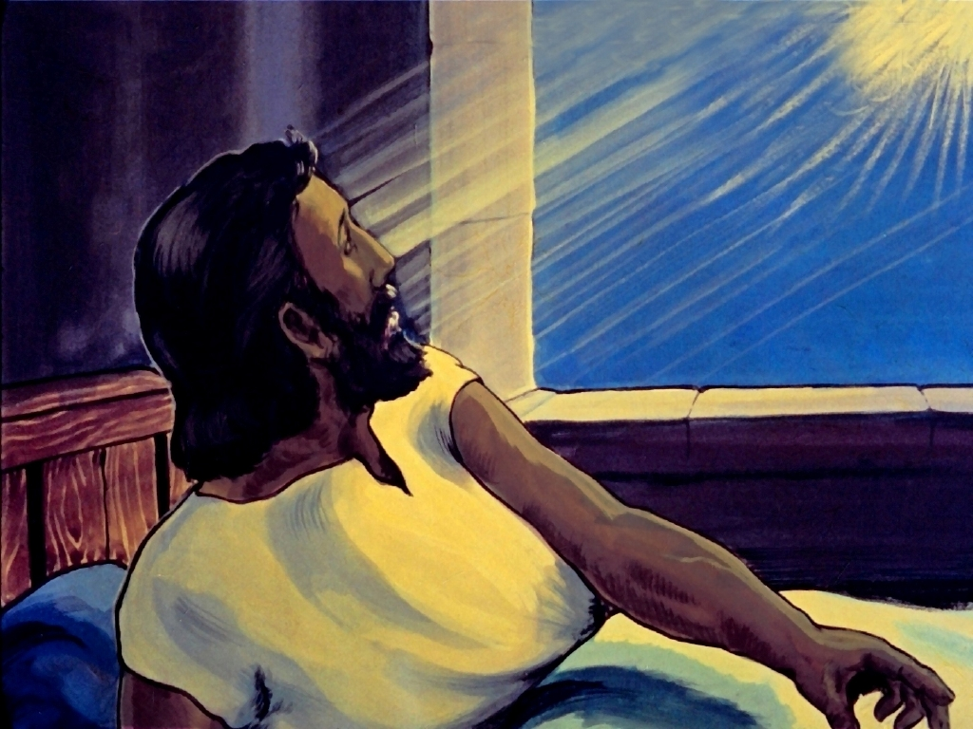

Slide 26
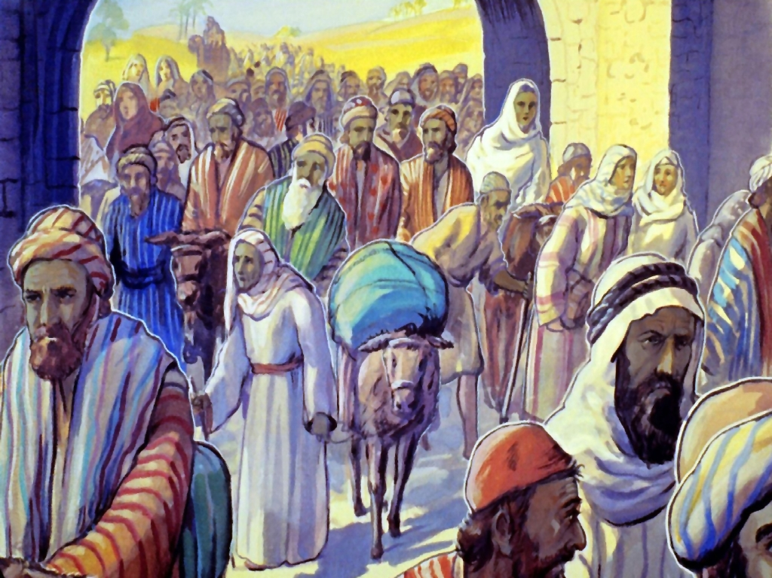
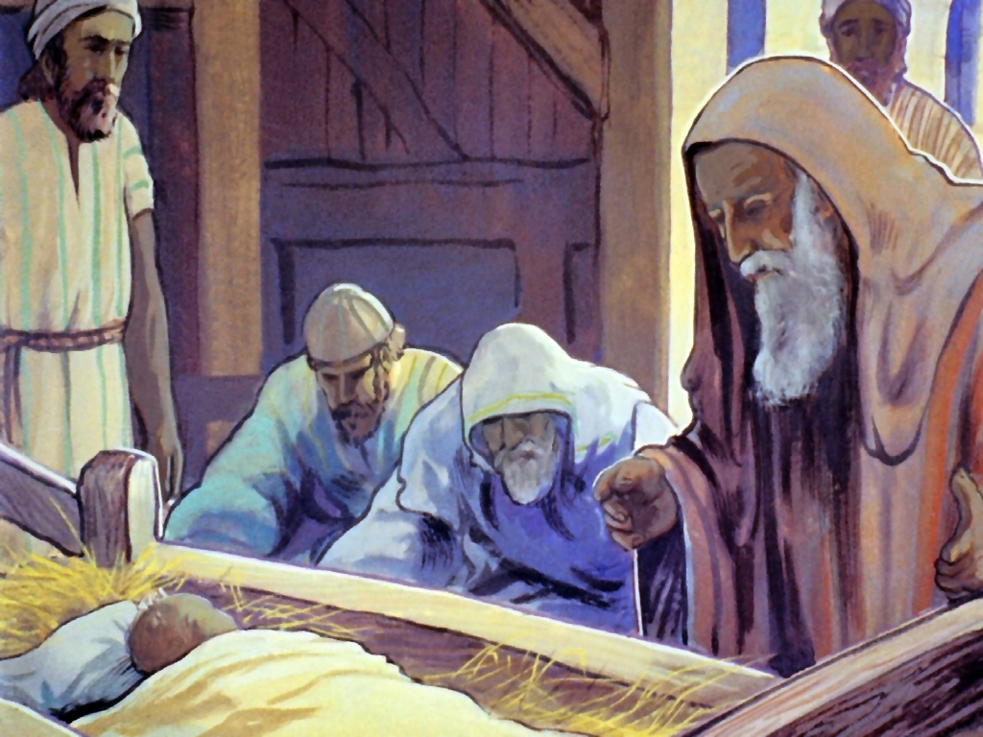

Slide 27
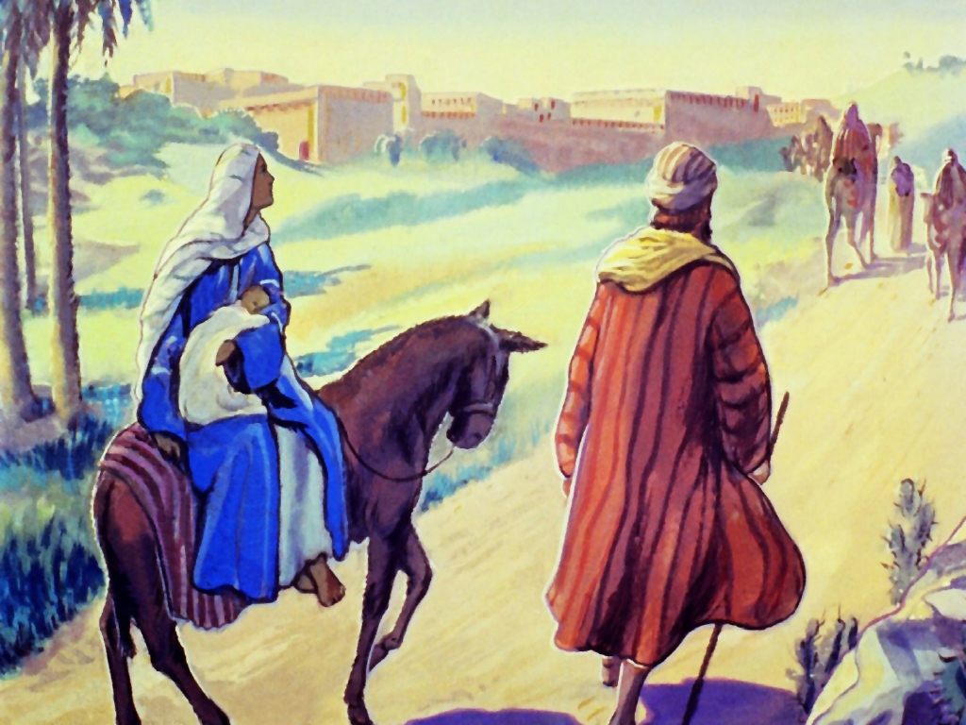
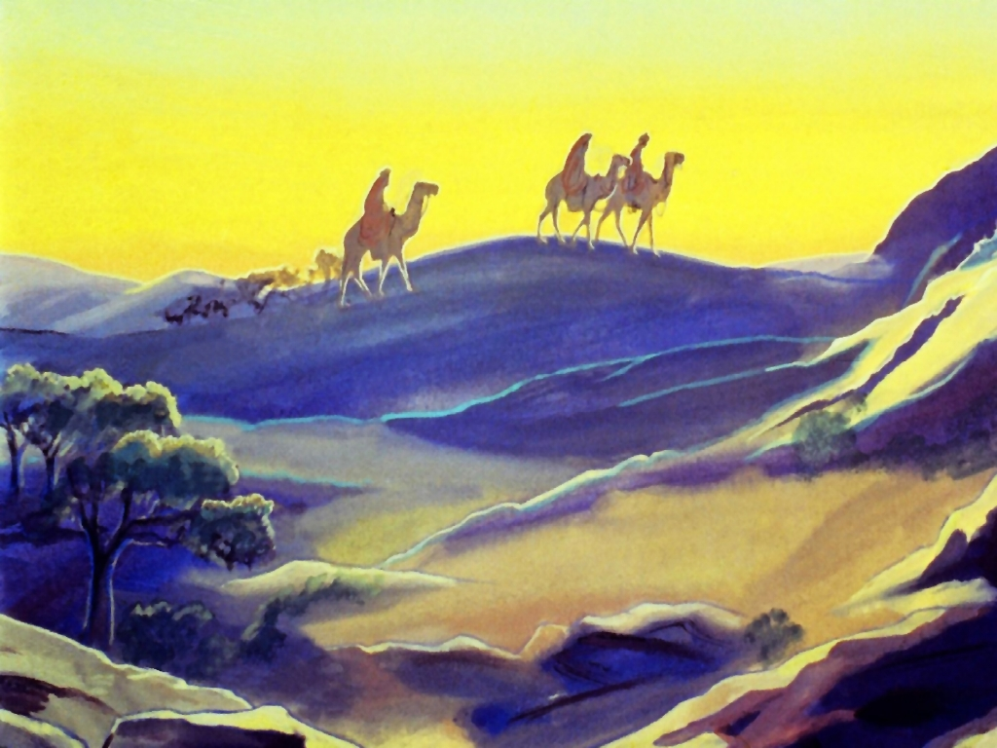

Slide 28
ACTIVITY: Packing for the Journey Relay

Slide 29
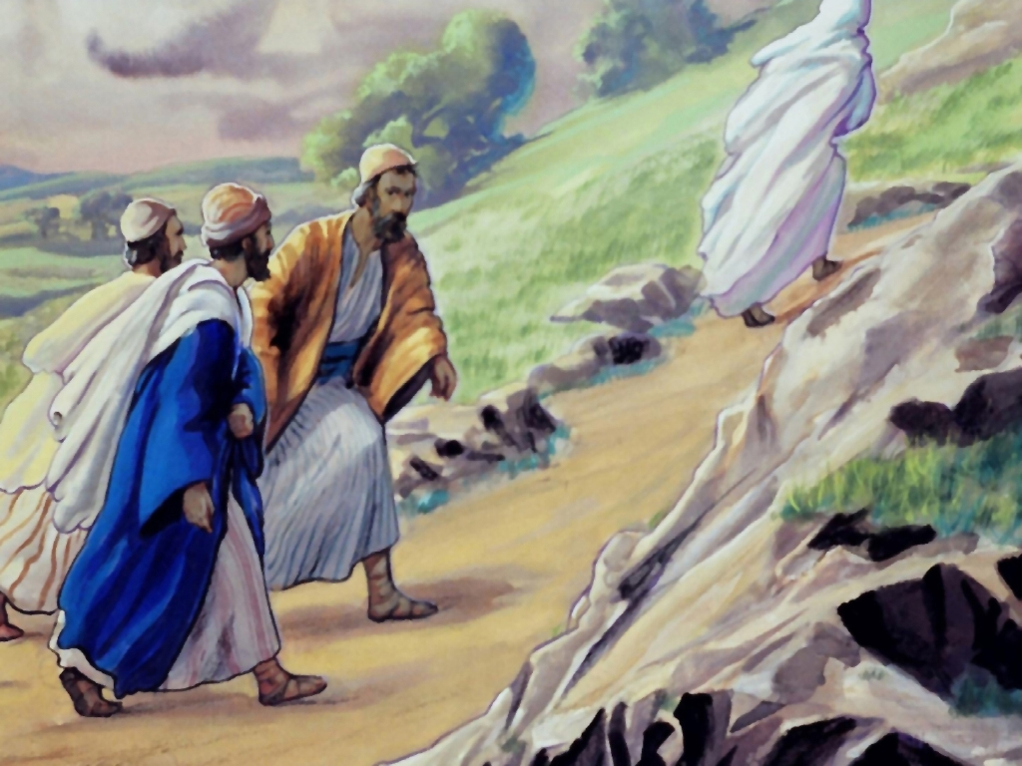
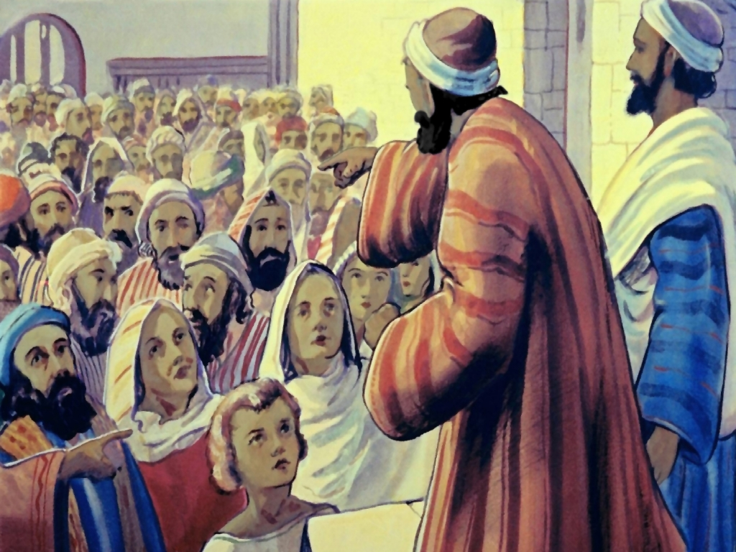

Slide 30
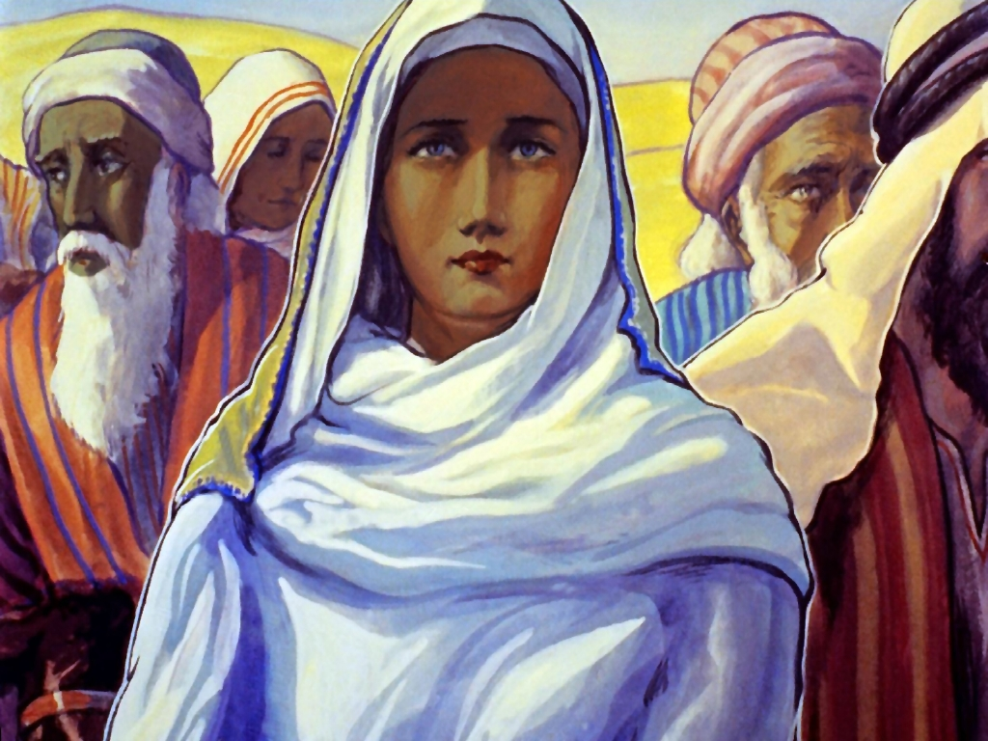

Slide 31
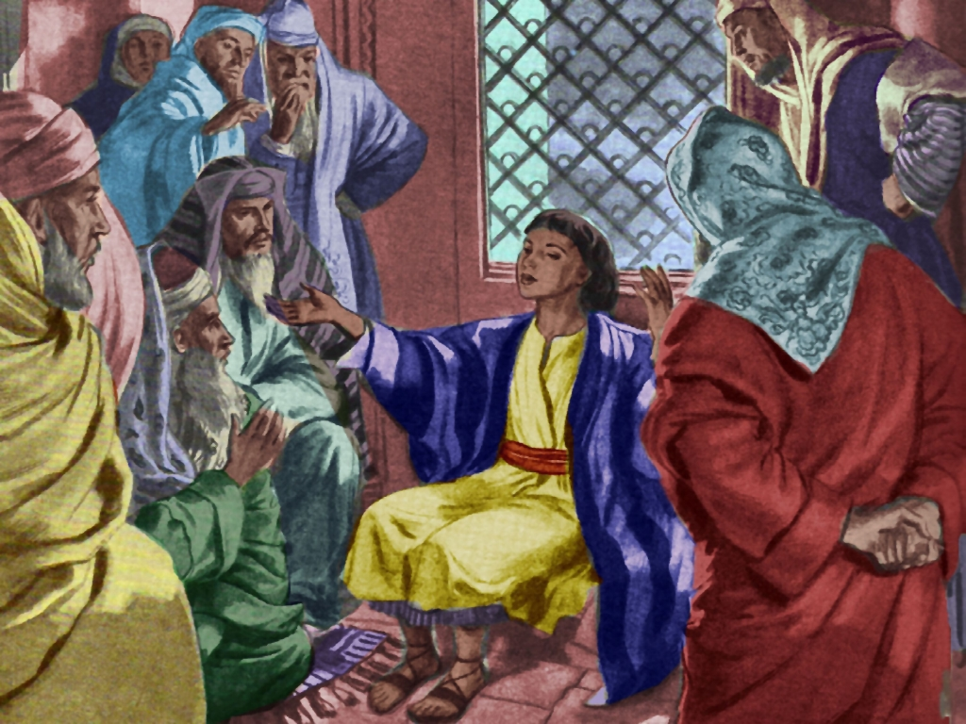

Slide 32
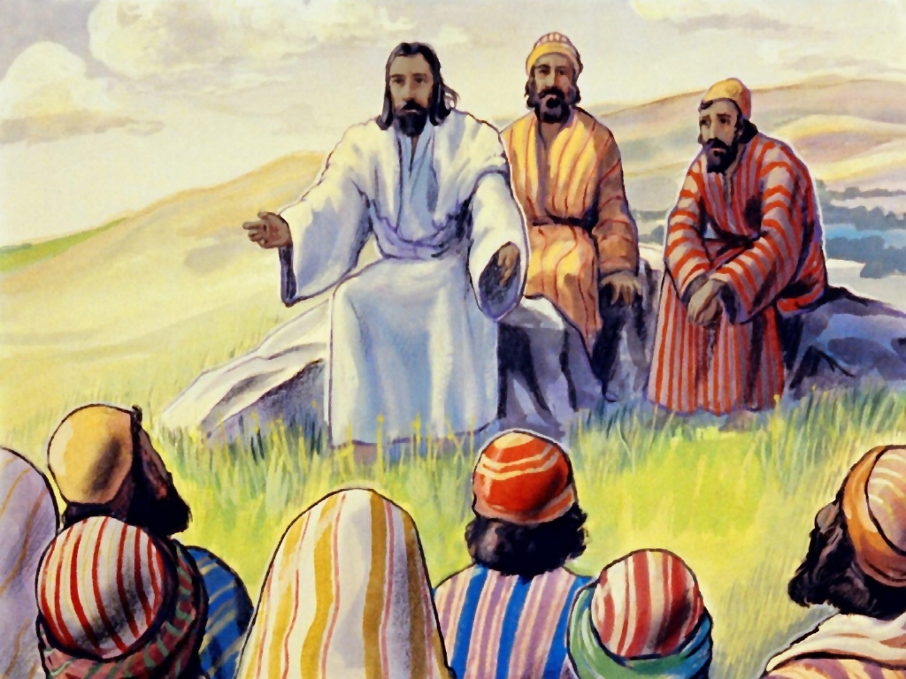

Slide 34
© Copyright 2022 Parable Patch Productions. All rights reserved.
Bible Story Images used with permission from The Glory Story @ theglorystory.com.
No images from any part of this file are to be downloaded, reproduced,
or used separately from this PowerPoint presentation.

