Slide 1
Husbands, love your wives,
even as Christ also loved the church,
and gave himself up for it.
- Ephesians 5:25 -

Slide 2
Biblical Truths about Marriage
God created marriage.
God has a purpose for a married man and woman.
Marriage is a symbol of Jesus’ love for the Church.

Slide 3
PUPPET SHOW: Boaz & Ruth

Slide 4
MALE AND FEMALE, HE CREATED THEM
A husband and a wife, a husband and a wife,
Divinely joined together serving God throughout this life.
Male and female, He created them,
A bride and groom, to love and learn from Him.
It’s a picture, a loving mystery
Of Jesus as the Bridegroom, the Church, His bride.
He loved us, before the dawn of history.
He laid down His life, for our sins He died.

Slide 6
TRAIN UP A CHILD
Train up a child. Train up a child.
On their own, they’re loud and messy And a teeny bit wild.
This world is all a jumble; they don’t know what to do.
So, God gave them parents to lead them wisely through.

Slide 7
God has a special job for every mom and dad to do—
Teach your child to follow after Christ and cling to what is true.
Plant treasures from God’s word down deep in their hearts.
The nurture of the Lord—That’s where wisdom truly starts.

Slide 8
Train up a child. Train up a child.
On our own, we’re loud and messy And a teeny bit wild.
This world is all a jumble; we don’t know what to do.
So, God gave us parents to lead us wisely through.

Slide 9
Genesis 1:27
So God created man in his own image, in the image of God
created he him; male and
female created he them.”

Slide 10
Genesis 1:27
So God created man in his own image, in the image
of God created he him; male and female created
he them.”

Slide 11
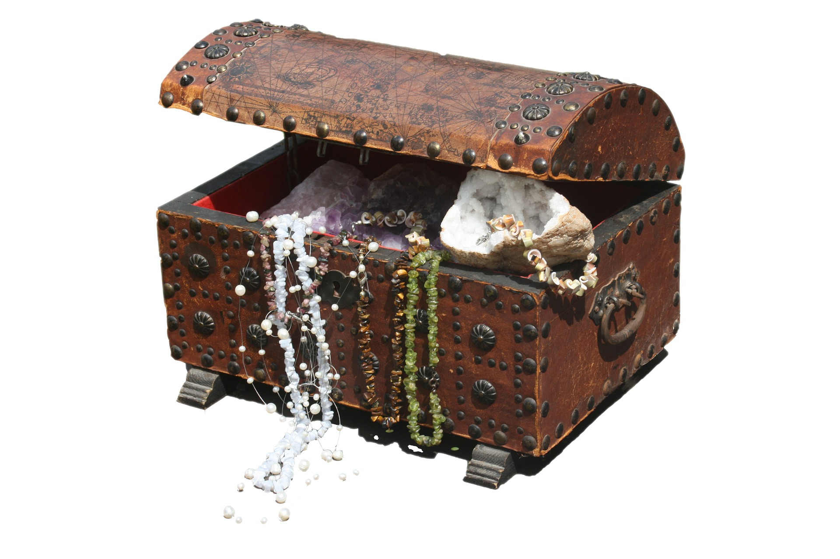
What would you pay to redeem
these treasures?

Slide 12
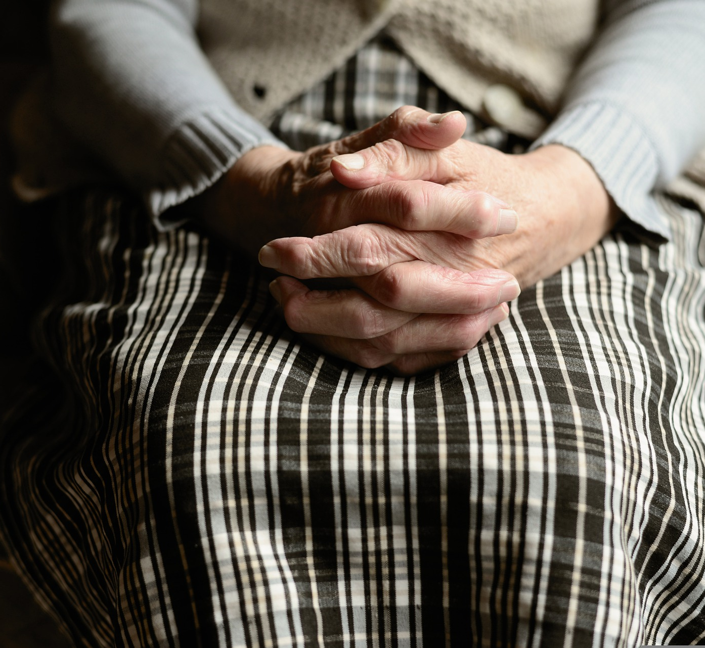
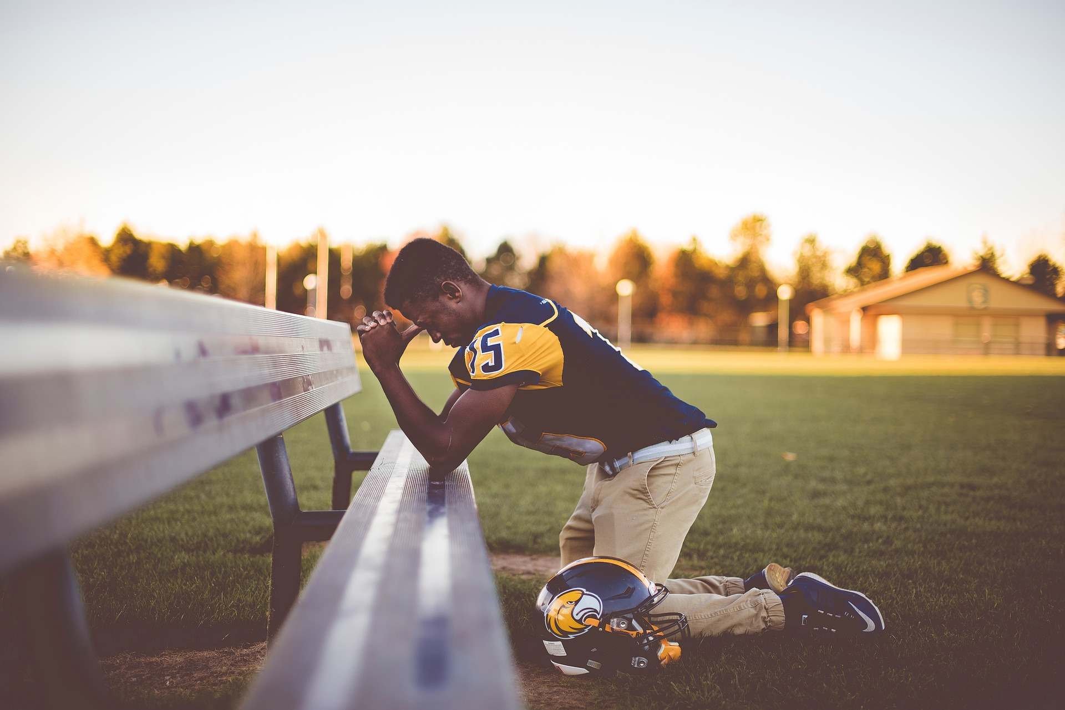
What Price Did Jesus Pay to Redeem Those Who Called on His Name?

Slide 13
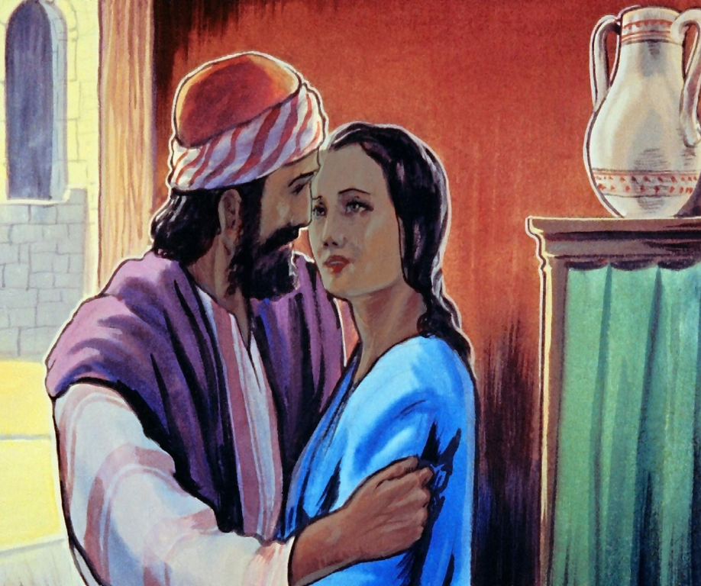
THE EMBELLISHMENTS:
The Story of
Boaz & Ruth

Slide 16
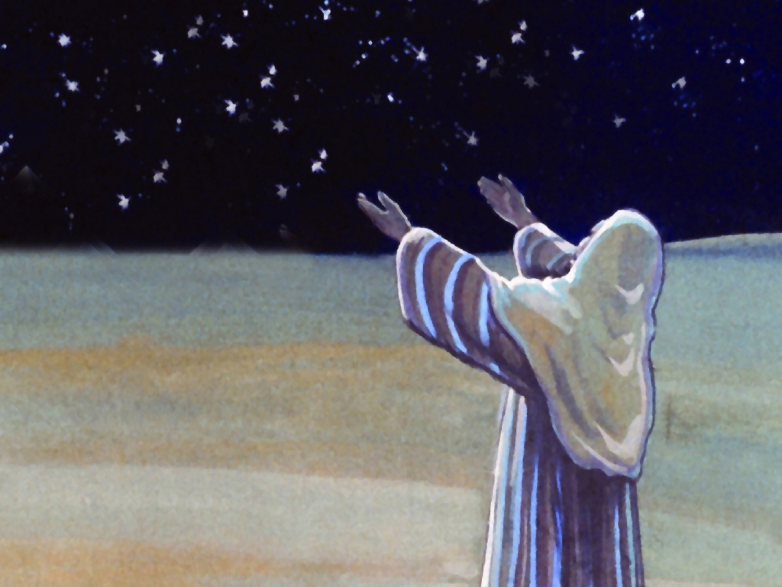
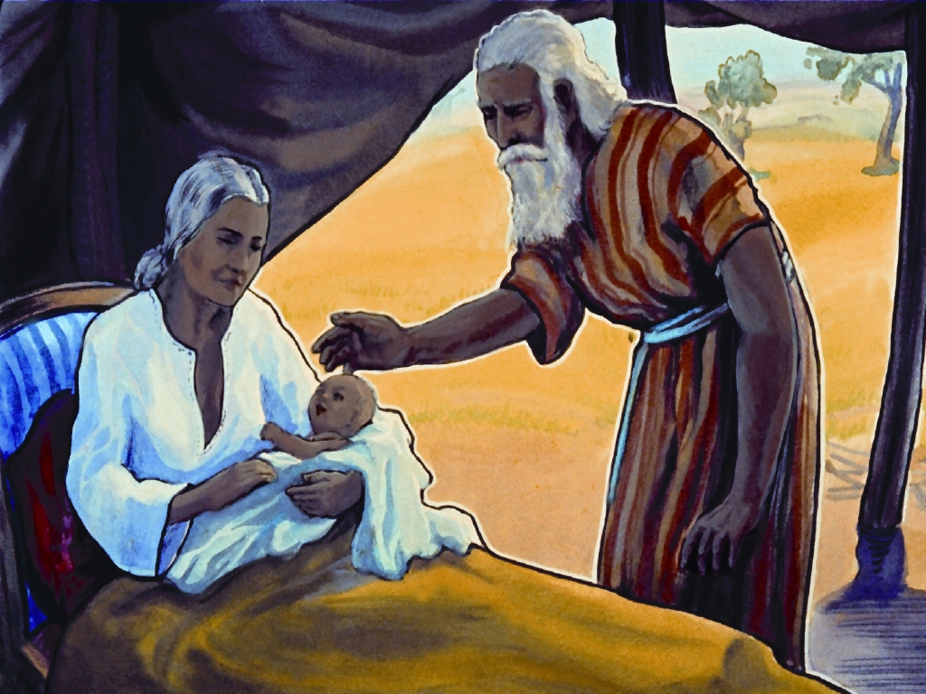

Slide 17
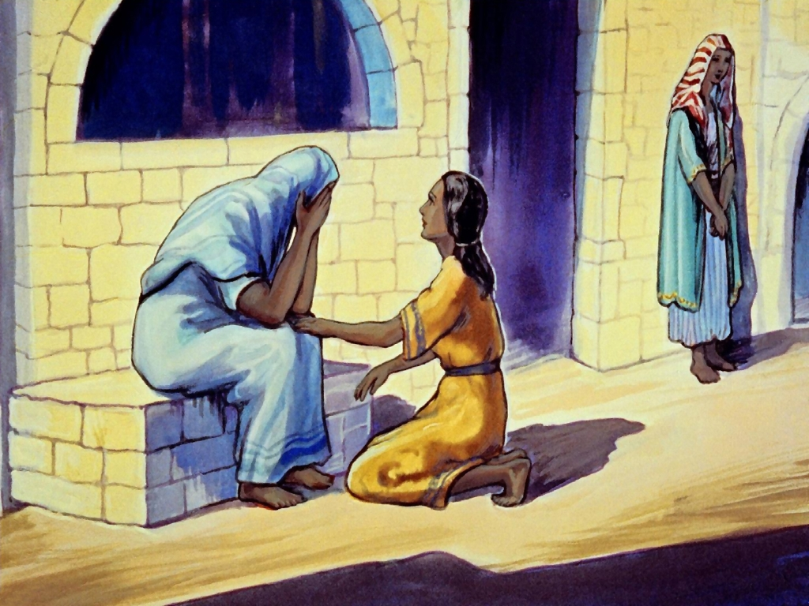

Slide 18
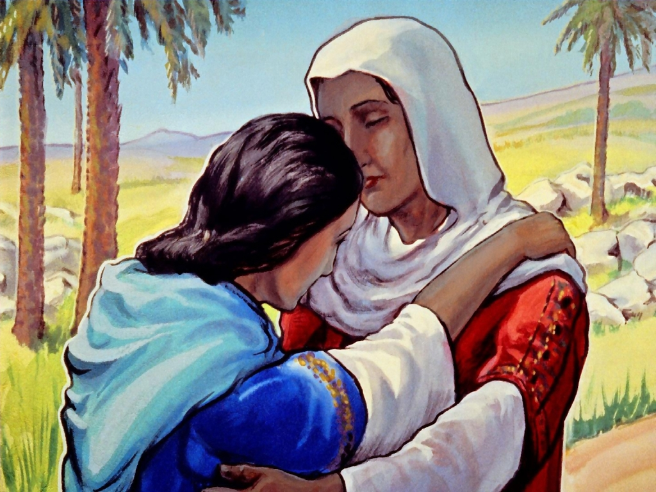
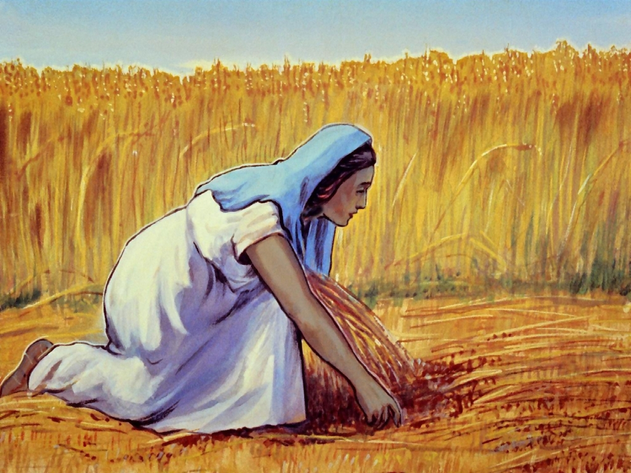

Slide 19
ACTIVITY: Gleaning Barley

Slide 20
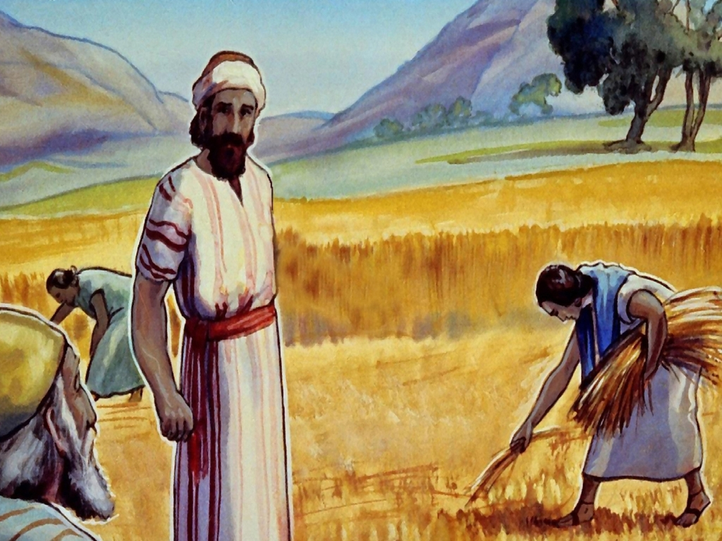

Slide 21
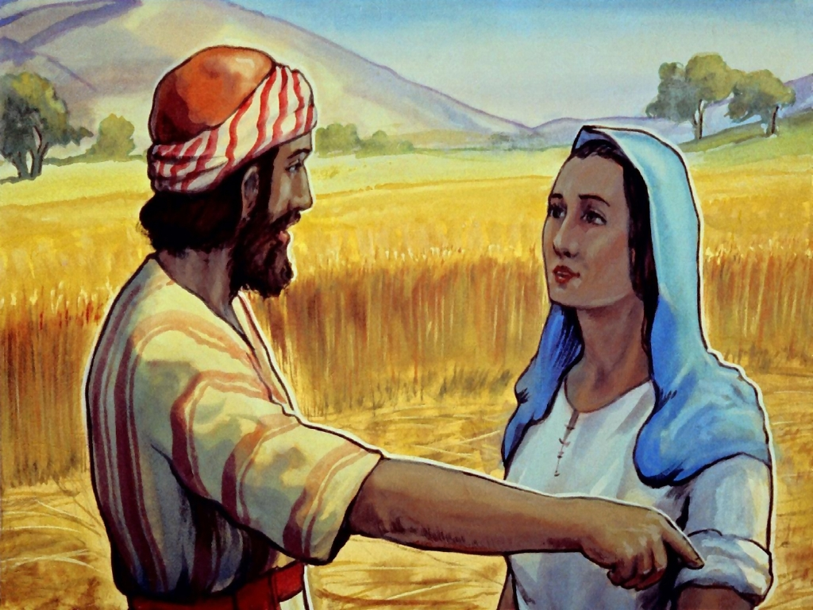
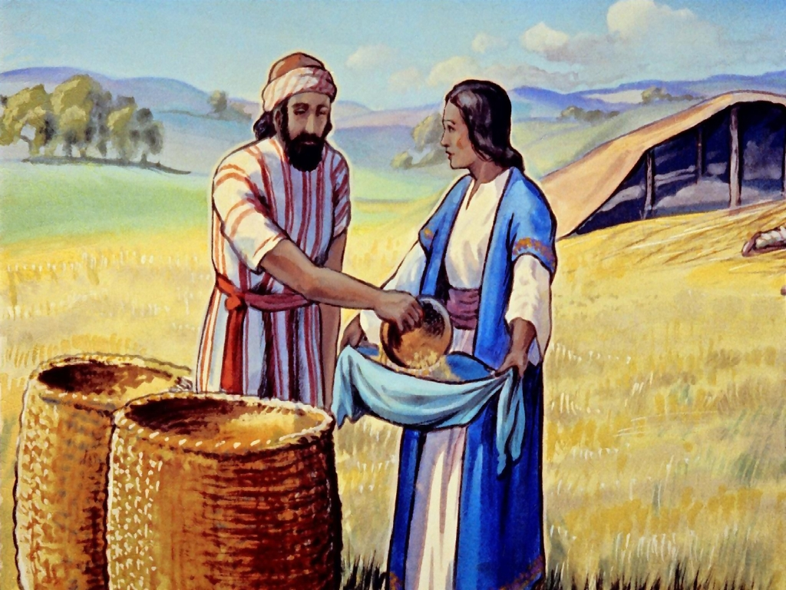

Slide 22
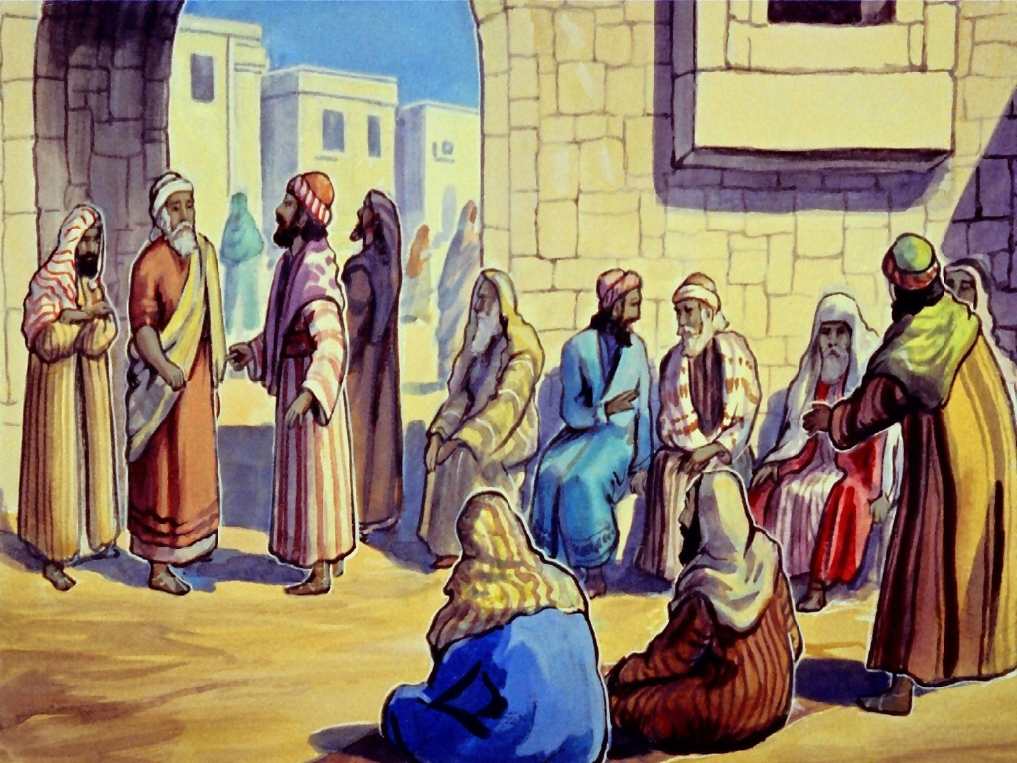
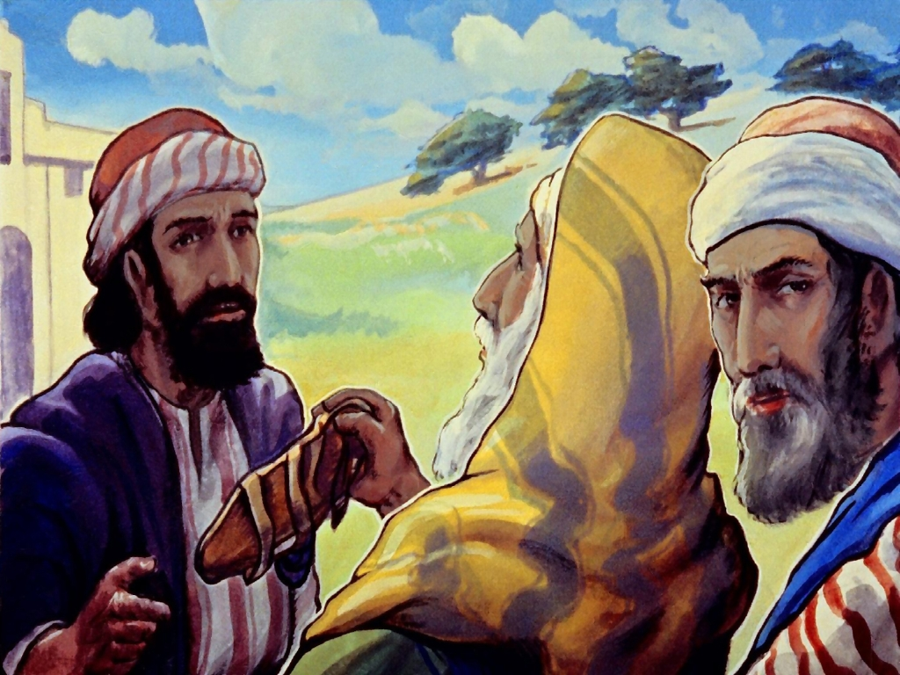

Slide 23
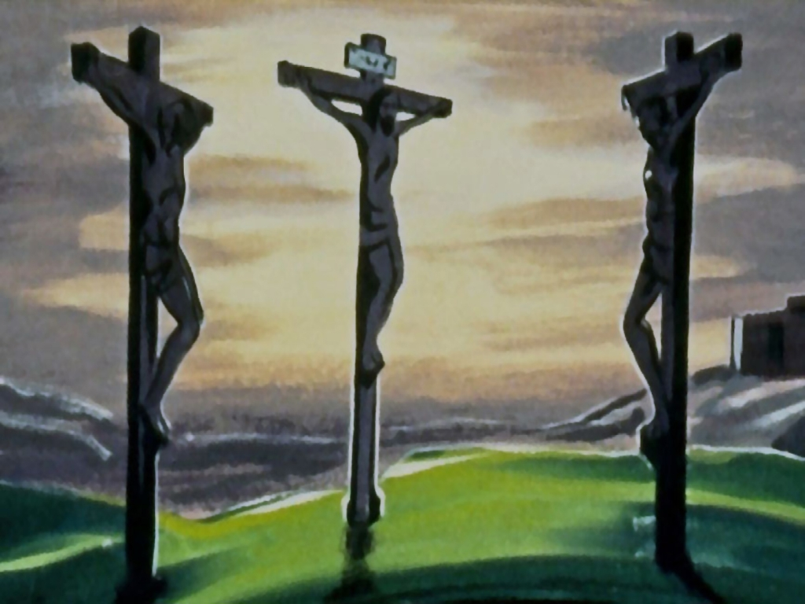

Slide 25
© Copyright 2022 Parable Patch Productions. All rights reserved.
Bible Story Images used with permission from The Glory Story @ theglorystory.com.
No images from any part of this file are to be downloaded, reproduced,
or used separately from this PowerPoint presentation.

