Slide 1
Husbands, love your wives,
even as Christ also loved the church,
and gave himself up for it.
- Ephesians 5:25 -

Slide 2
Biblical Truths about Marriage
God created marriage.
God has a purpose for a married man and woman.
Marriage is a symbol of Jesus’ love for the Church.

Slide 3
PUPPET SHOW: Abraham & Sarah

Slide 4
MALE AND FEMALE, HE CREATED THEM
A husband and a wife, a husband and a wife,
Divinely joined together serving God throughout this life.
Male and female, He created them,
A bride and groom, to love and learn from Him.
It’s a picture, a loving mystery
Of Jesus as the Bridegroom, the Church, His bride.
He loved us, before the dawn of history.
He laid down His life, for our sins He died.

Slide 6
THE FAMILY TREE OF JESUS
The family tree, the family tree,
Jesus is the root of the family tree.
Because He died, and rose again,
You can be a branch of His family tree.
Adam and Eve enjoyed the world God made,
But had to leave the garden because they disobeyed.
Generations later the sinful world was dark.
God kept Noah’s family safe in the ark.

Slide 7
Genesis 1:27
So God created man in his own image, in the image of God
created he him; male and
female created he them.”

Slide 8
Genesis 1:27
So God created man in his own image, in the image
of God created he him; male and female created
he them.”

Slide 9
Waiting

Slide 10
Waiting for Creation’s Wonders
It takes 3 years from seed to first harvest.

Slide 11
Waiting for Creation’s Wonders
It takes 6 months up to 4 years to form a single pearl.

Slide 12
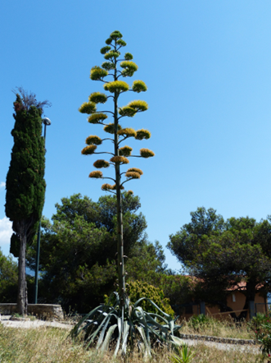
Waiting for Creation’s Wonders
It takes 25-30 years before blooming.

Slide 13
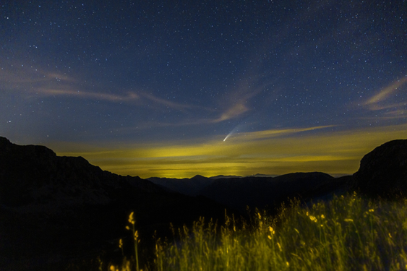
Waiting for Creation’s Wonders
Halley’s Comet is only visible every 75 years.

Slide 14
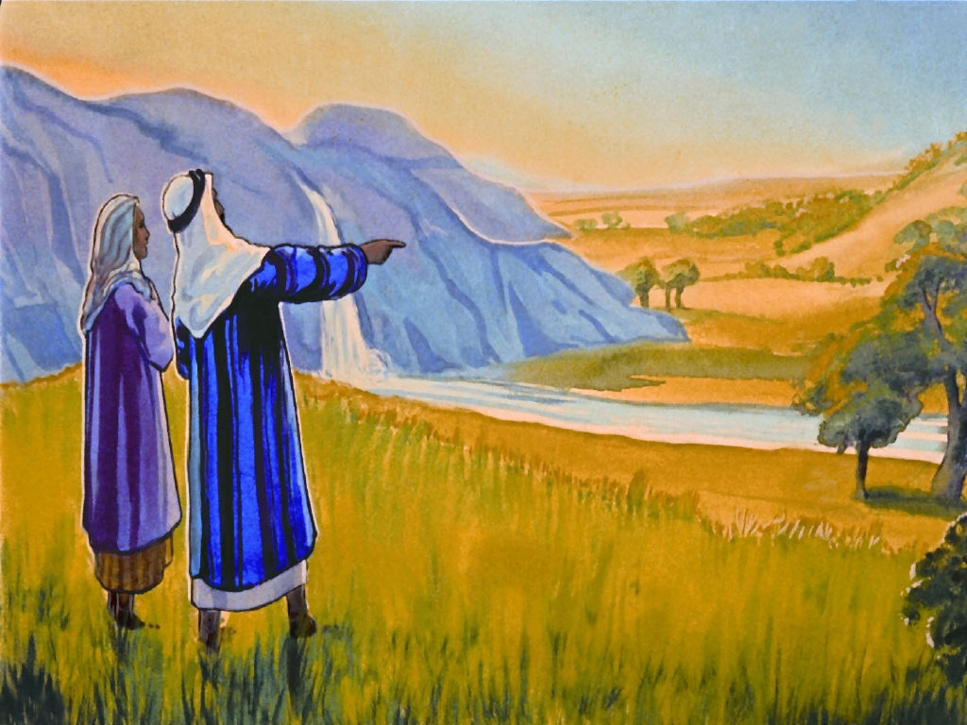
THE NOTIONS:
The Story of
Abraham & Sarah

Slide 16
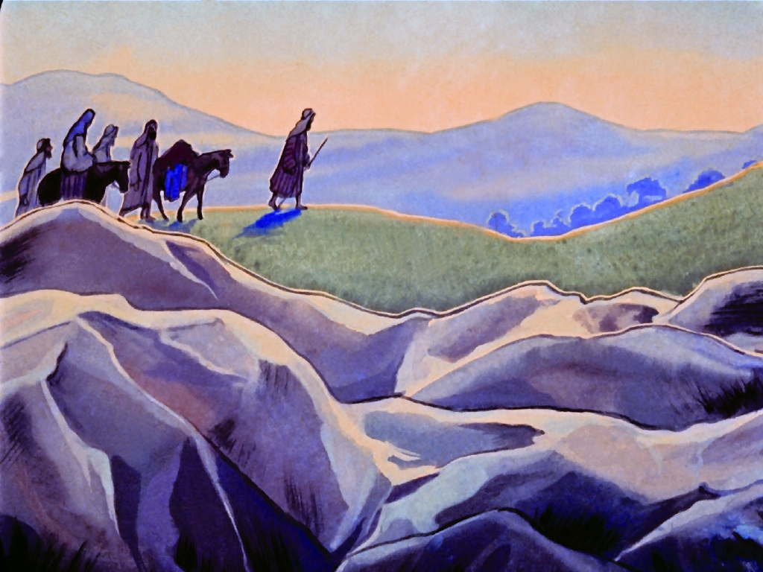

Slide 18
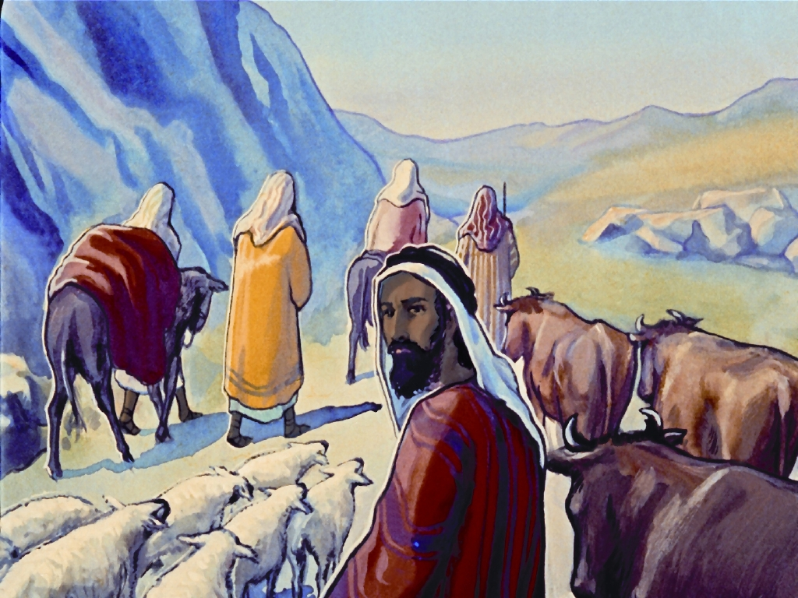

Slide 19
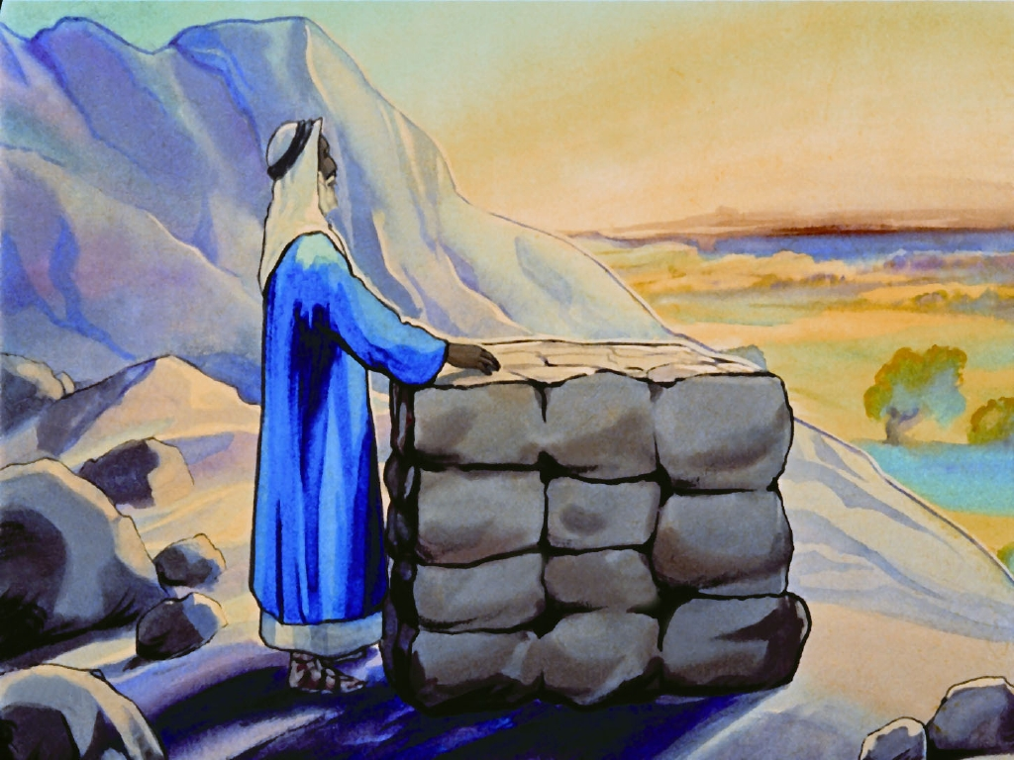

Slide 20
ACTIVITY: Building an Altar

Slide 22
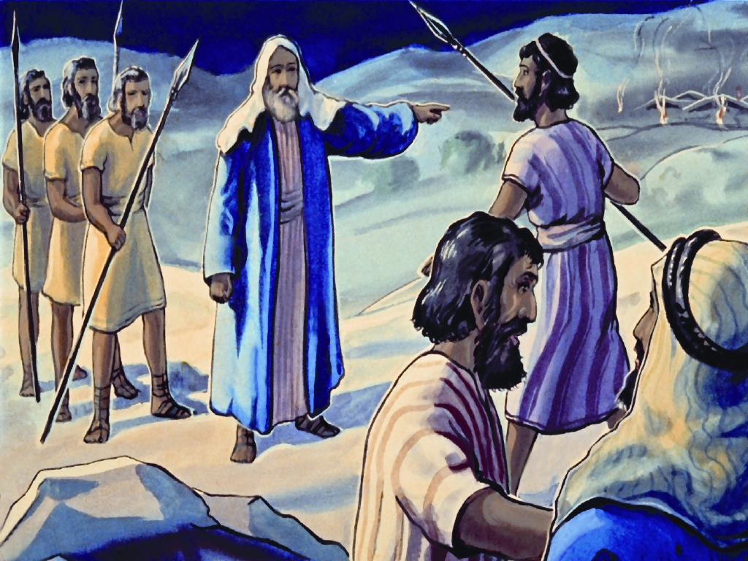

Slide 23
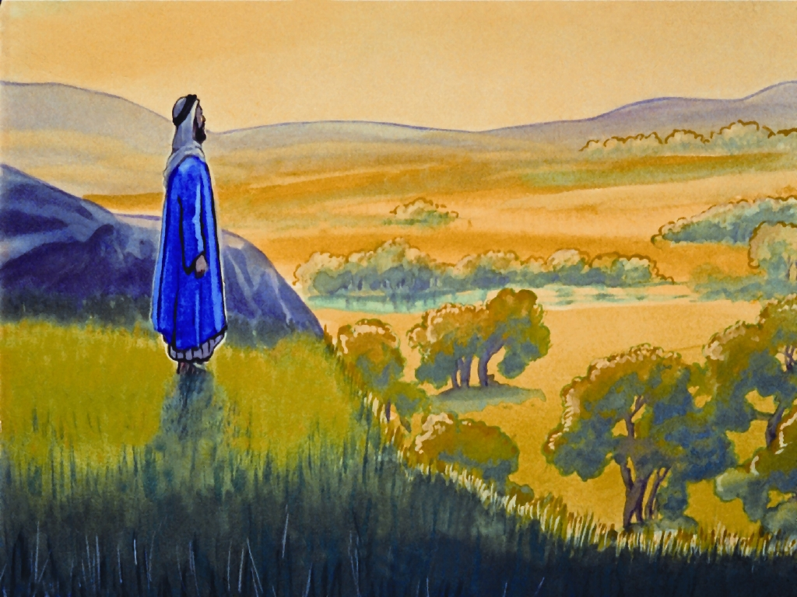
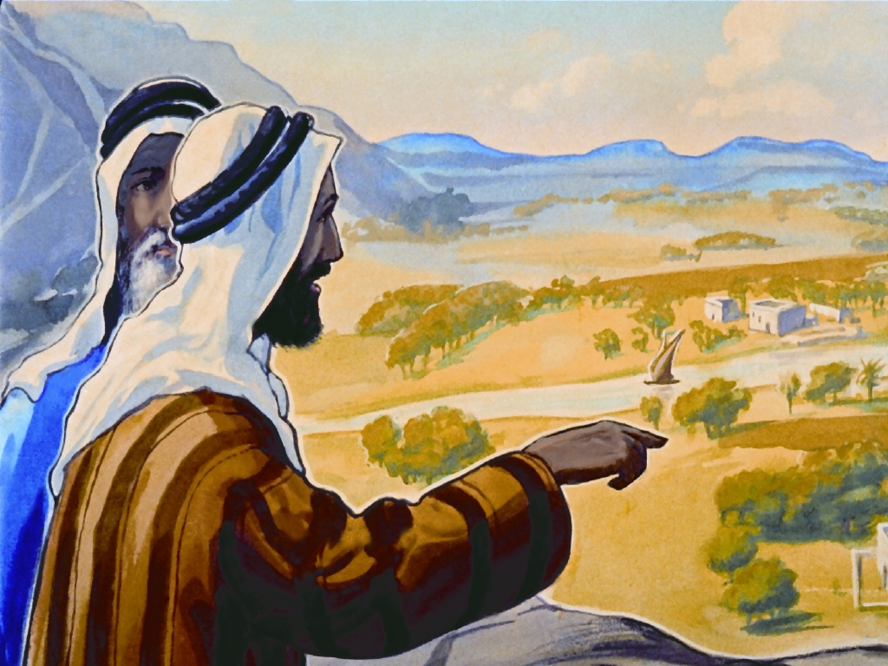

Slide 24
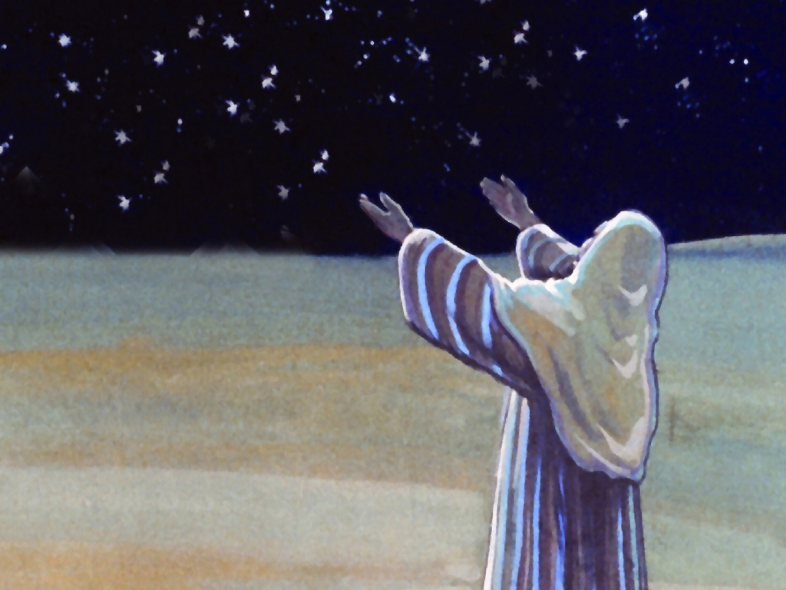

Slide 25
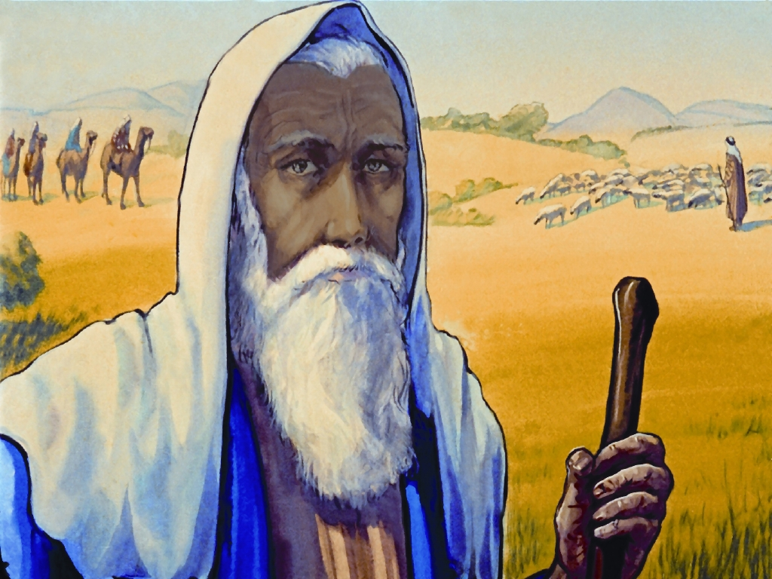

Slide 26
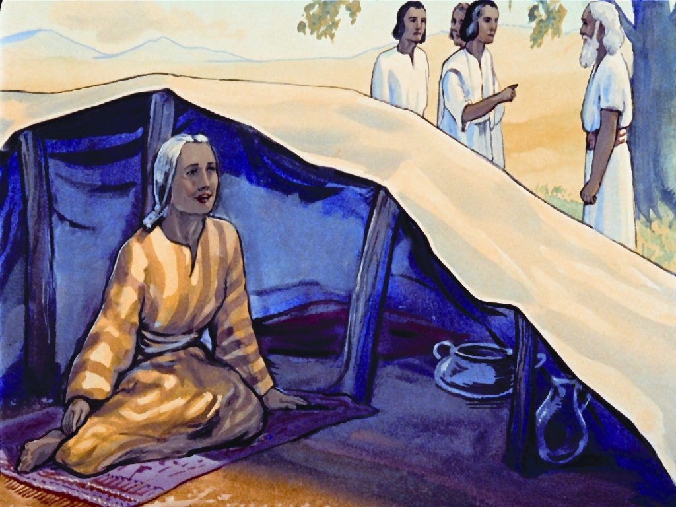

Slide 27
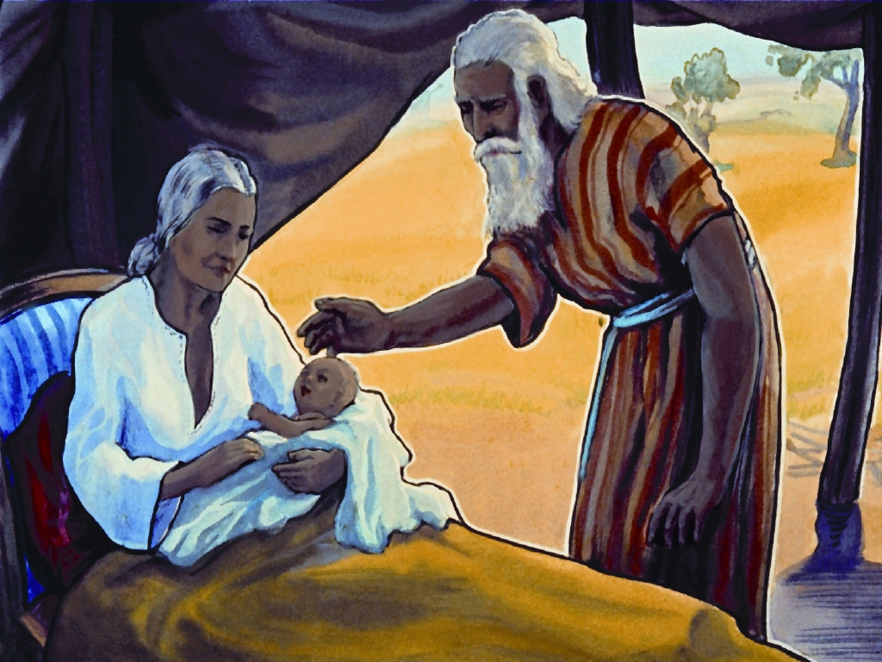
“Wait on the LORD: be of good courage, and he shall strengthen thine heart: wait, I say, on the LORD.”

Slide 29
© Copyright 2022 Parable Patch Productions. All rights reserved.
Bible Story Images used with permission from The Glory Story @ theglorystory.com.
No images from any part of this file are to be downloaded, reproduced,
or used separately from this PowerPoint presentation.

