Slide 1
Husbands, love your wives,
even as Christ also loved the church,
and gave himself up for it.
- Ephesians 5:25 -

Slide 2
Biblical Truths about Marriage
God created marriage.
God has a purpose for a married man and woman.
Marriage is a symbol of Jesus’ love for the Church.

Slide 3
PUPPET SHOW: Noah & His Wife

Slide 4
MALE AND FEMALE, HE CREATED THEM
A husband and a wife, a husband and a wife,
Divinely joined together serving God throughout this life.
Male and female, He created them,
A bride and groom, to love and learn from Him.
It’s a picture, a loving mystery
Of Jesus as the Bridegroom, the Church, His bride.
He loved us, before the dawn of history.
He laid down His life, for our sins He died.

Slide 6
THE FAMILY TREE OF JESUS
The family tree, the family tree,
Jesus is the root of the family tree.
Because He died, and rose again,
You can be a branch of His family tree.
Adam and Eve enjoyed the world God made,
But had to leave the garden because they disobeyed.
Generations later the sinful world was dark.
God kept Noah’s family safe in the ark.

Slide 7
Genesis 1:27
So God created man in his own image, in the image of God
created he him; male and
female created he them.”

Slide 8
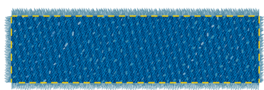
Genesis 1:27
So God created man in his own image, in the image
of God created he him; male and female created
he them.”

Slide 9
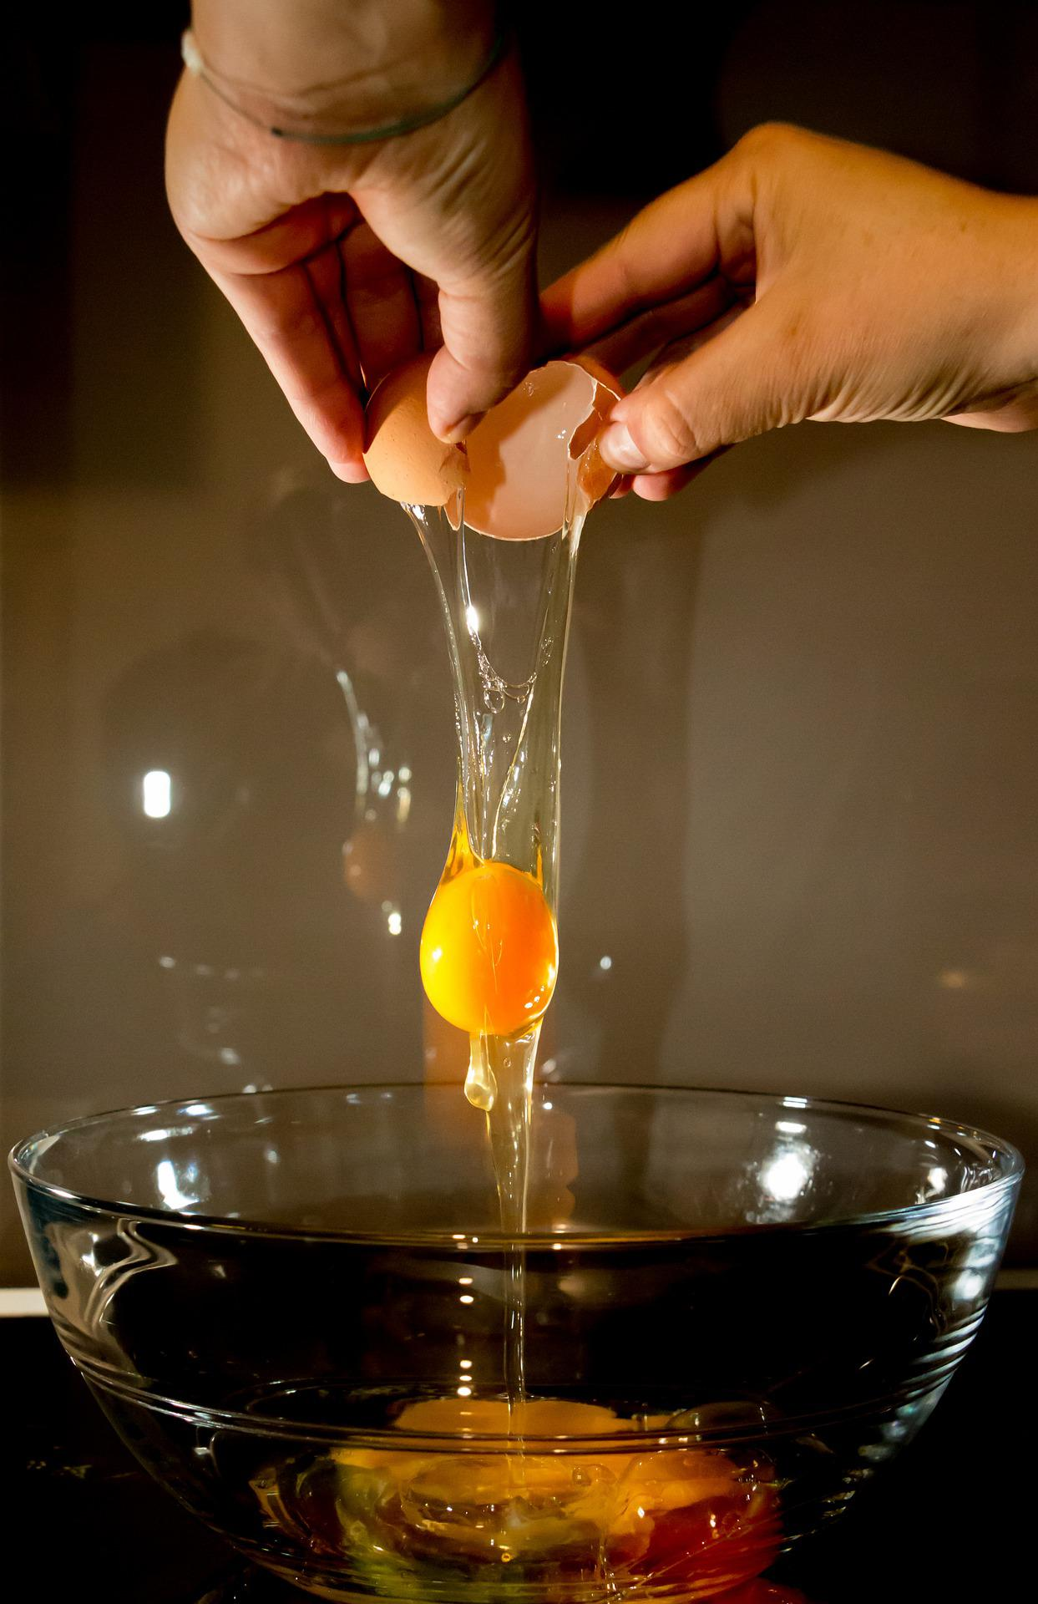
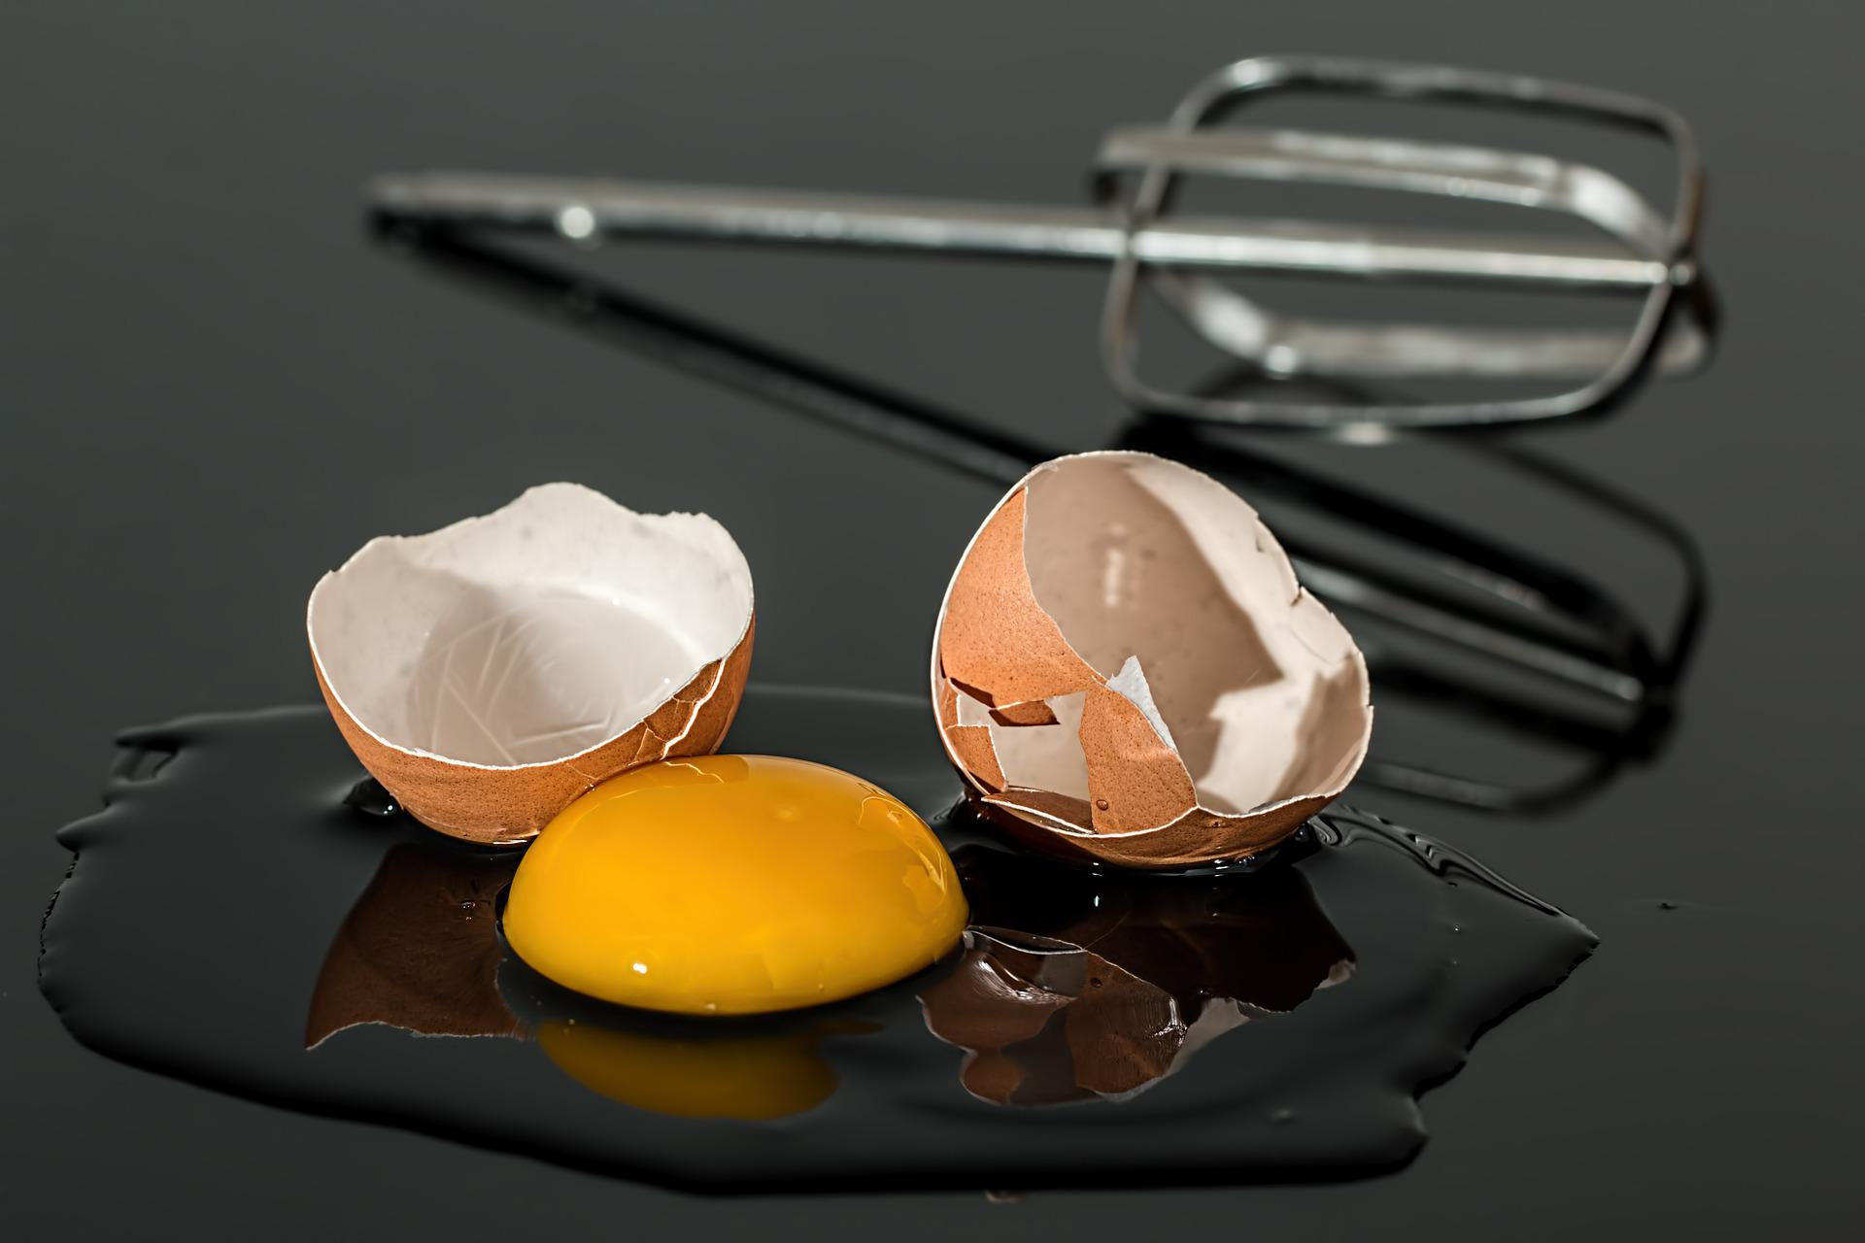
Starting Over

Slide 10
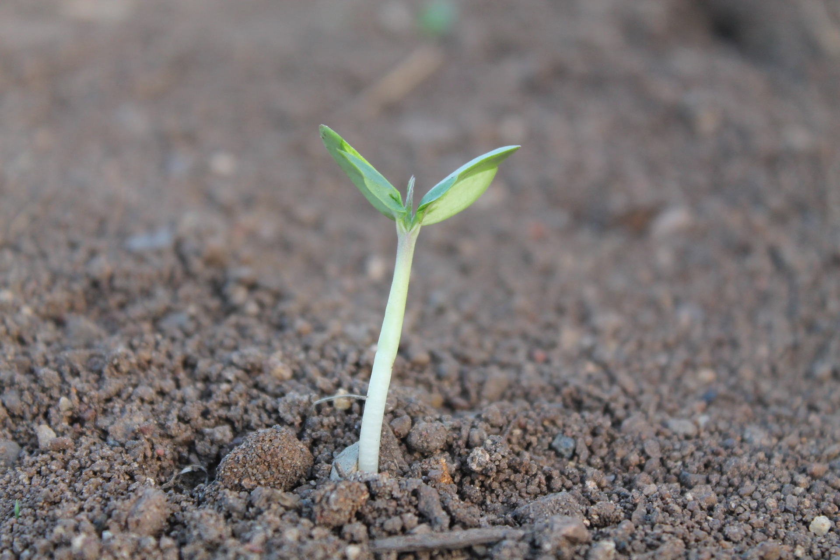
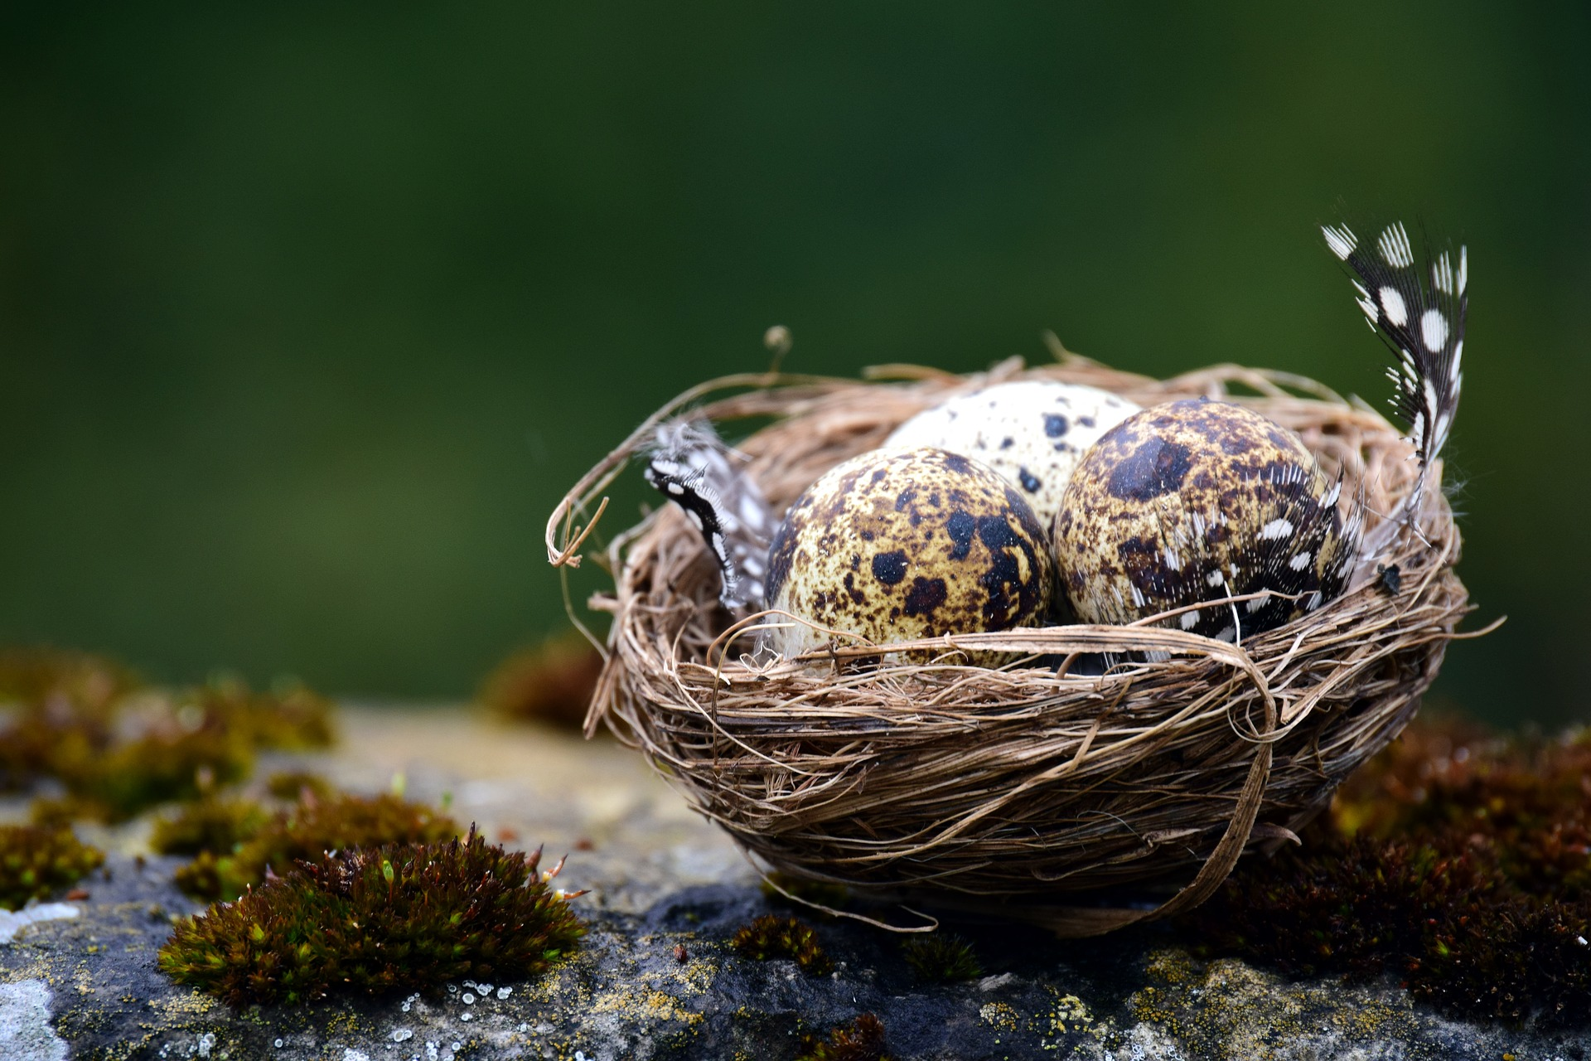
New Beginnings in Creation

Slide 11
THE SEAM RIPPER:
The Story of
Noah & His Wife

Slide 17
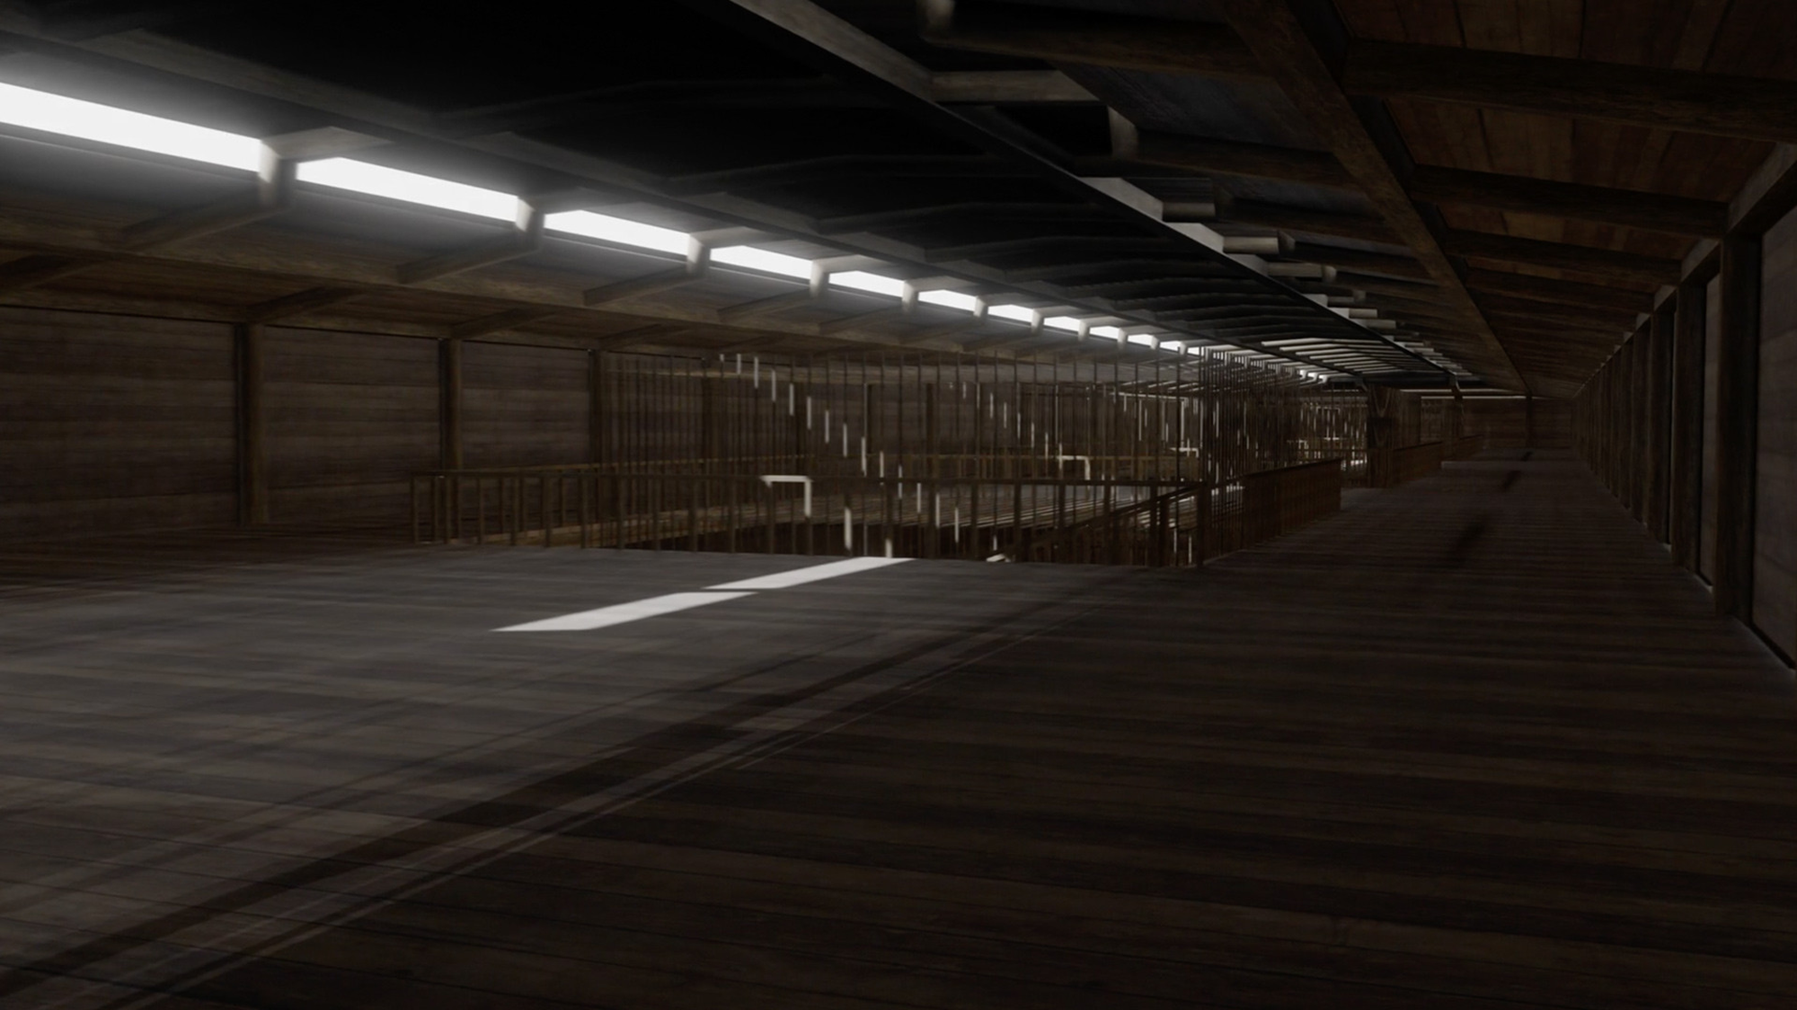

Slide 18
ACTIVITY: The Animals Enter Two by Two

Slide 23
“And God spake unto Noah, and to his sons with him saying, and I, behold, I establish my covenant with you, and with your seed after you.”

Slide 25
Noah’s White Dove A dove flew out from Noah’s hand ‘Til it could find a place to land A place that’s high, a place that’s low How far will the white dove go? A dove flew out from Noah’s hand ‘Til it could find a place to land.

Slide 26
© Copyright 2022 Parable Patch Productions. All rights reserved.
Bible Story Images used with permission from The Glory Story @ theglorystory.com.
No images from any part of this file are to be downloaded, reproduced,
or used separately from this PowerPoint presentation.

